Slide 1


Biology in a Box
A science education outreach program brought to you by a partnership
between The University of Tennessee and the National Institute for Mathematical and Biological Synthesis
Visit us on the web at http://biologyinabox.utk.edu
Biology in a Box Team
Program Director/Author/Lead Editor: Dr. Susan E. Riechert (University of Tennessee)
Science Collaborators: Dr. Thomas C. Jones (East Tennessee State University), Dr. Stan Guffey (University of Tennessee)
Mathematics Collaborators/Editors: Dr. Suzanne Lenhart (NIMBioS), Kelly Sturner (NIMBioS), Lu Howard (University of Tennessee)
Outreach Coordinator: Dr. Lynn Champion (University of Tennessee)
Workshop Coordinators: Kathy DeWein (Austin Peay State University), Gale Stanley (Jacksboro Middle School)
Production/Assistant Editor: J.R. Jones (University of Tennessee)
Previous Contributors: Sarah Duncan, Communications (formerly with NIMBioS), Rachel Leander, Math Collaborator (formerly with NIMBioS)
This unit revised October 2012
Copyright 2012 by Biology in a Box, and the University of Tennessee. All materials in this unit and on the Biology in a Box web server (biologyinabox.utk.edu, eeb.bio.utk.edu/biologyinbox) may not be reproduced or stored in a retrieval system without prior written permission of the publisher, and in no case for profit.

Slide 2
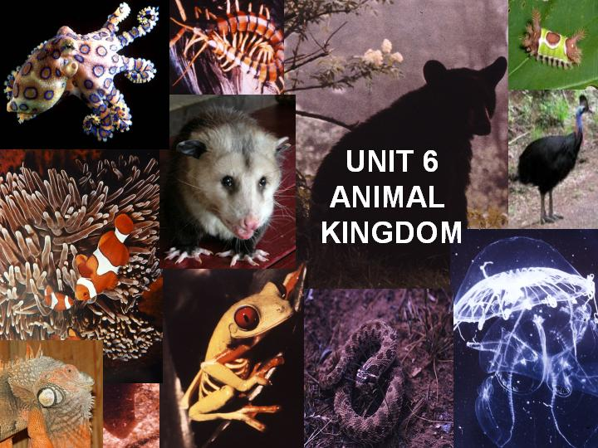

Slide 3
Homepage Unit 6: Animal Kingdom
Click on underlined text to go to information and exercises!
Materials List (Best not to let students see this information until after they have completed Exercise 3 and/or 6!)
Introduction
Exercise 1: Graph that Diversity
Exercise 2: What’s that Reflection?: Animal Symmetry
Exercise 3: Guess that Phylum
Exercise 4: Diagram those Traits
Exercise 5: Sort these Animals (grades K-2)
Exercise 6: Who’s in that Tree?: Animal Phylogenies
Exercise 7: What is that Animal?
Exercise 8: Pass that Gas!
Exercise 9: Follow that Spiral!
Suggested Readings
Links
Clicking the icon on other slides will bring you back to this page!

Slide 4
Unit 6: Animal Kingdom – Materials List
Spinner
Magnifying glass
Game poster for phylogenetic tree
Mystery Animal
Phylum Representatives
  #1 – Sponge
  #2 – Jellyfish
  #3 – Liver fluke
  #4 – Roundworm
  #5 – Clam
  #6 – Bristle worm
  #7 – Crustacean (krill, crab, or isopod)
  #8– Starfish
  #9 – Lancelet
  #10 – Insect
  #11 – Cephalopod (octopus or squid)
  #12 – Hydra
  #13 – Leech
  #14 – Planaria
  #15 – Coral
Phylum Representatives (continued)
  #16 – Arachnid (spider, harvestman, scorpion, tick, or mite)
  #17 – Earthworm
  #18 – Tapeworm
  #19 – Fish
  #20 – Sea urchin
  #21 – Snail
  #22 – Centipede or millipede
  #23 – Sea squirt

Slide 5
Introduction
There are so many different organisms on Earth.
To help deal with the great diversity of organisms, scientists have assigned them into general groups called Kingdoms.
The members of each Kingdom share physical characteristics and similar feeding patterns.
There are six Kingdoms in all, each of which will be discussed briefly on the next few slides.
This unit focuses on the animal kingdom, but first we will discuss the other kingdoms and what makes them different from animals.
  Try to keep in mind these important differences amongst these organisms, but also take note of similarities amongst the various kingdoms!

Slide 6
Introduction
The Kingdoms Bacteria and Archaea
  Microscopic organisms (bacteria and blue-green algae) that have their genetic material (DNA) loose in a single cell.
  The cell has no compartments where specific cell functions are carried out.
  Formerly grouped together in the Kingdom Monera, bacteria and archaea are genetically distinct, warranting a distinction between the two.
The Kingdom Protista
  One-celled organisms with compartmentalized cells.
  The genetic material that passes on the traits of parents to their offspring is located in a compartment called the nucleus.

Slide 7
Introduction
Like the Kingdom Protista, the following three Kingdoms have cells with compartmentalized functions.
Organisms belonging to these Kingdoms, however, are composed of many cells (multicellular) and are much larger and more complex than the protists.
The Kingdom Fungi
  Organisms (e.g. mushrooms and molds) that feed on non-living organic matter (deceased organisms and fecal material ).
  In the process, these organisms decompose or break down the organic material into simpler chemicals.
The Kingdom Plantae
  Organisms (e.g. trees, ferns, & mosses) that make their own food using the energy from sunlight.
The Kingdom Animalia
  All of the multi-celled organisms (like insects, fish, and mammals) that depend on other living organisms for food

Slide 8
In this Unit, the student will:
Understand the level of diversity (richness of species) that exists in the different kingdoms
Learn how scientists group organisms in the animal kingdom by common characteristics
Learn that scientists have different views on how organisms should be grouped.

Slide 9
Exercise1. Graph that Diversity
The Kingdom Animalia has by far, the greatest diversity of named organisms (approximately 1,400,000 kinds or species)
Compared to…
  Kingdom Plantae (320,000 species)
  Kingdom Fungi (100,000 species)
  Kingdom Protista (100,000 species)
  Kingdom Bacteria (10,000 species)
  Kingdom Archaea (259 species)
  Write these numbers of species down, as you will use them in a moment to graphically compare the diversity of named organisms in each of these kingdoms.

Slide 10
Objective
You have already been provided the numbers of described species for each Kingdom. However it is often easier to compare numbers by looking at them visually (in a picture called a graph).
In this exercise, students will compare the diversity among the kingdoms graphically.

Slide 11
Directions
Divide the class into groups of three or four students
Each group will use graph paper (templates provided following discussion of each graph type) to visually compare the diversity of organisms among the different Kingdoms using the two forms of graphs listed below:
  Bar graph (vertical or horizontal)
  Pie Chart
On the following slide are examples of both vertical and horizontal bar graphs.

Slide 12
Examples of bar graphs comparing the number of students in different grades at a school.
Vertical bar graph
Horizontal bar graph
Now make your own bar graph (either vertical or horizontal, or both if your teacher requests) showing the diversity of named species in each of the six kingdoms of life.
For additional instructions on making bar graphs, click HERE. Otherwise, click HERE to go on to the next exercise.

Slide 13
Instructions for Making a Bar Graph
Below is an example of a bar graph that you can use as a guide.
Each bar in the sample graph represents a different grade level, and the height of each bar indicates the number of students in each grade at a particular school.
Similar to the example, your graph will show a different bar for each of the Kingdoms used to classify living organisms, and the height of each bar will represent the number of species in each of the Kingdoms.

Slide 14
Instructions for Making a Bar Graph
If each bar in your graph will represent one Kingdom, how many bars will your graph have in all?
If you said 6, you are exactly right!
Look at the numbers of species in the six Kingdoms below:
  Kingdom Animalia (1,400,000 species)
  Kingdom Plantae (320,000 species)
  Kingdom Fungi (100,000 species)
  Kingdom Protista (100,000 species)
  Kingdom Bacteria (10,000 species)
  Kingdom Archaea (259 species)
These numbers are quite a bit larger than the numbers in the sample graph, so you are going to need to find a way to represent all the numbers so that your graph will fit on your paper. The y-axis, or vertical axis, will show the numbers of species in each Kingdom using a scale that you choose.

Slide 15
Instructions for Making a Bar Graph
Remember that the scale you use for indicating numbers of species must be divided into even increments as you move up the vertical (side) axis!
  In order to help you with this, consider the following questions:
  What is the smallest number of species in any one Kingdom?
  What is the largest number of species in any one Kingdom?
  What is the difference in the largest and smallest number of species?
  How many spaces do you have to work with on your graph paper?
You will use that information to help you design your graph. Because of the large difference between the largest and smallest numbers of species, and also because of having limited space on your paper, the scale intervals will need to represent a large number. In other words, you may want each space to represent 40,000 or 50,000 so that all Kingdoms’ numbers will be represented on your graph.

Slide 16
Instructions for Making a Bar Graph
Whichever number you choose as your interval, be sure to begin at 0 (zero) and end at a number that will include the largest number in your data.
Also, be sure that each interval is equally spaced and represents the same difference as you move up the graph.
Your horizontal axis, also called the x-axis, will indicate the names of the six different Kingdoms.
Make sure your bars are the same width and are evenly spaced across the graph.
Also make sure that the bars are wide enough to see them clearly and to compare the height of the bars easily.

Slide 17
Instructions for Making a Bar Graph
Using graph paper, decide how wide you want each bar and how much space you will allow between bars. Remember, your graph will have six bars.
Use a ruler or straightedge to draw your y-axis and your x-axis. Leave enough space on the left side of the graph and at the bottom of the graph for your labeling.
Draw your graph and label each part: x-axis, y-axis, scale, kingdoms, and title.
Your labels should be clear enough so that anyone picking up your graph will know what it represents by just looking at what you have included in the picture!

Slide 18

Graph paper
template

Slide 19
When you are done checking your bar graph, look at the example of a pie chart below. This chart shows the same data as the previous bar graphs.
Then construct your own pie graph showing the data regarding the number of known species in each of the six kingdoms of life. For help on how to construct a pie chart, consult the following slide.
For an alternative “circle graph” exercise for younger students, click HERE. Otherwise, click anywhere else to continue.

Slide 20
How to make the pie chart:
Step 1. Find the total number of species in all of the kingdoms.
Step 2. Find the fraction of the total number of species that belong to each kingdom.
For example, if I have total of 32 candies and 8 of those candies are red, the fraction of red candies compared to the total is 8/32, or ¼ when simplified. You should have six fractions.
The numerators of your fractions should have a sum equal to the denominator (the total number of species in all Kingdoms).
Since your fractions involve large numbers, you may wish to find the size of your circle sections another way. You could also find the decimal equivalent to your fractions and use that information to help you find the measures of your circle sections.
Using a calculator, divide the numerator of each fraction by its denominator. You now have a decimal number that may be several digits long. Round this number to the hundredths place. Multiply that decimal number by 360 degrees. Round that number to the nearest whole number. Your answer will be the number of degrees of the circle for that Kingdom. Repeat for each of the six Kingdoms, being sure to write down your information for each section.

Slide 21
How to make the pie chart (continued):
Step 3. Find the size of each sector’s interior angle.
For example, if you were making a circle graph using the candies example from Step 2, you could multiply the fraction representing red candies (1/4) by 360 degrees.
One-fourth of 360º is 90º, so the section of a circle representing the red candies would measure 90º.
Note that by following the alternative procedure using the decimal equivalents of your fraction, you would still get the same answer.
One-fourth is equal to 0.25, and when multiplying this number by 360º, you would still get a measurement of 90º.

Slide 22
How to make the pie chart (continued):
Remember, you should have one sector for each kingdom, and the size of a sector’s interior angle should be proportional to the fraction of the species that the sector represents, as follows:
Step 4: Use a protractor to draw the sectors of your pie chart. Your teacher may provide you with a template (found on the next slide) to help you construct your pie chart.

Slide 23
Pie chart
template

Slide 24
How to make the pie chart (continued):
Step 4 (continued): First, however, you should find the center of the circle.
  You can find the center by folding the circle in half, being sure the edge of the circle is exactly lined up with no overlaps (you may find it helpful to hold the paper up toward a light to help you see the circle edge). You may want to begin with a vertical (lengthwise) paper fold.
  Crease the paper when the edges of the circles are lined up correctly.
  Unfold, and then fold in a different direction in the same way you folded the first time, with the edge exactly lined up all the way around the edge of the circle. Crease the paper.
  When you unfold the paper, you should see a point where the two crease lines intersect inside the circle. That is the center point of your circle.
  Mark the center point with a pencil.

Slide 25
How to make the pie chart (continued):
Step 4 (continued): Now, using a ruler or other straightedge, draw a line from the center point to any point on the edge of the circle. You will use this line to begin dividing your circle into sections. Your first interior angle is measured using the center point of the circle as the vertex of the angle, and the line you just drew as your base line.
To construct additional segments of the chart, you can use each new line added for a kingdom as your base line for drawing the angle to represent the next kingdom that you add to the chart.

Slide 26
How to make the pie chart (continued):
Step 4 (continued): Using your degree measurements you calculated from the fractions or decimals in Step 3, choose one of the six Kingdoms and measure its angle, making a mark on the edge of the circle so you know where to connect the line.
Draw a line from the center of the circle to the mark you made at the edge of the circle to create the first section.
After measuring the fifth section, the remaining section should measure roughly the degrees appropriate for your sixth section (it may not be exact due to rounding the decimals earlier, but it should be very close).
Step 5: Choose a color to represent each kingdom. Color the sectors of your pie chart accordingly and create a legend or key.
Step 6: Title your pie chart.
Go to the next slide to see examples of what your completed graphs should look like!

Slide 27
The graphs that you produced should look similar to the ones presented here.

Slide 28
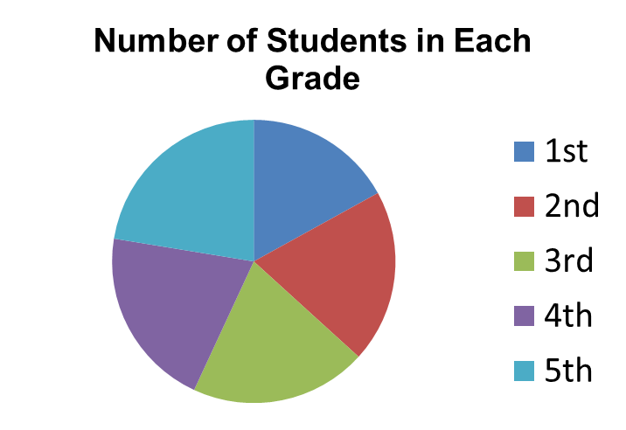
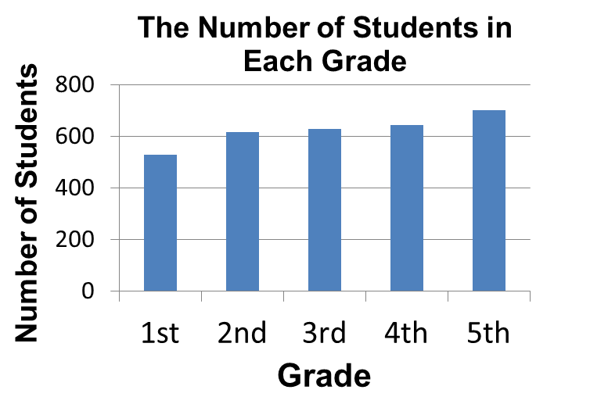
Compare the two types of graphs above, and use them to answer the following questions:
Q1. Which grade has the most students? Which grade has the second most students? Which graph makes it easier to see the answer to this question?
Q2. How are the students distributed among the five grades? That is, do a few of the grades contain most of the students, or are the students fairly evenly distributed amongst all of the grades?

Slide 29
Compare the two types of graphs above, and use them to answer the following questions:
Q3. Approximately how many students are in the third grade? Which graph did you use to answer this question? Could you have used the other graph to answer the question? Why or why not?
Q4. What kinds of questions are easier to answer by looking at a bar graph? What kinds of questions are easier to answer by looking at a pie chart?

Slide 30
Answer Time!
Q1. Which grade has the most students? Which grade has the second most students? Which graph makes it easier to see the answer to this question?
The fifth grade has the most students. The fourth grade has the second most students. It is easier to see that this is the answer by looking at the bar graph.
Q2. How are the students distributed among the five grades? That is, do a few of the grades contain most of the students or are the students fairly evenly distributed amongst all of the grades?
The students are fairly evenly distributed among all of the grades. This is easier to see by looking at the pie chart.

Slide 31
Answer Time!
Q3. Approximately how many students are in the third grade? Which graph did you use to answer this question? Could you have used the other graph to answer the question? Why or why not?
There are about 630 students in the third grade. We used the bar graph to answer this question. We could not have used the pie chart, because the pie chart displays the fraction of total students in each grade, and not the number of students in each grade.
Q4. What kinds of questions are easier to answer by looking at a bar graph? What kinds of questions are easier to answer by looking at a pie chart?
Bar graphs can be used to find or estimate exact data values. Pie charts can be used to describe how data is distributed.

Slide 32
Alternative “Circle Graph” Exercise for Younger Students
Using your bar graph, measure one-inch wide strips of construction paper the length of each of your bars, using a different color for each Kingdom, and being careful to make your strips the exact length of the bars.
Label each bar with the name of the Kingdom it represents.
Tape the bars together end-to-end without overlapping the bars.
Once all six bars are connected, complete the circle by taping the ends of the long strip together, end-to-end, without overlapping.
You can see from the different colors which Kingdom includes the most species and which has the least.
Compare your circle to your bar graph, and answer the following questions:
  What similarities do you see?
  What differences do you notice?

Slide 33
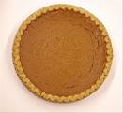
Exercise 2: What’s that Reflection?: Animal Symmetry
Many of the animals in this box exhibit self-similarity or symmetry, which can also be described as the duplication of body parts.
Some of the animals in the box exhibit a type of symmetry called radial symmetry.
These animals have a central point about which they can be rotated without changing their appearance. Thus this radial symmetry is a kind of rotational symmetry. Think of a pie.
You could rotate this pie any distance in either direction and it would look the same. It has a top (dorsum) and a bottom (venter), but you could divide the pie into two equal halves in any direction as long as you cut it through the center point.

Slide 34
Illustrating Rotational Symmetry
Take a square object & trace around it on a piece of paper.
Keep the object in place so that it is in the position it was in when you traced the shape.
Make a mark on one edge of the square so you can keep track of that particular edge.
Place a finger on the shape at its center and hold the shape firmly enough that it remains in place without sliding across the paper, but also so you can rotate it with your other hand. Turn the object just until the shape fits into the traced edges again. Do not move or slide the shape, only rotate it.
Turn it another time until it fits into traced edges again.
How many times can you turn the shape so that it fits into traced edges before you make one complete circle around the traced edges? You have just demonstrated the square’s rotational symmetry. The shape can be rotated four times and still look exactly the same. It was not moved to a different location, only turned about the center of the shape.

Slide 35
Finding the Degree Measure of
Rotation of Radially Symmetrical Objects
To find the degree measure of rotation of an object, you will think in terms of the 360 degrees in a circle because we are investigating the circular rotation of the object.
For this exercise, your teacher will provide you with a piece of graph paper with an x-axis and y-axis drawn on the paper and with a circle drawn on the graph with the center of the circle at the origin.
Notice that the x- and y-axis have divided the circle into four equal sections called quadrants. (Quad- is a prefix meaning four.)
Because of the unique properties of circles, we measure circles in degrees rather than other units we use for measuring distances or other amounts (like centimeters or liters).
  One complete circle has 360 degrees.

Slide 36
Finding the Degree Measure of
Rotation of Radially Symmetrical Objects
Look at the circle on your paper, and think about the following questions:
  If the x-axis and y-axis divide the circle into four quadrants, how many degrees of the circle are in one of the quadrants on the graph?
  Looking at just one of the quadrants on your graph and thinking about the number of degrees in that one quadrant, how many degrees does one-half of that one quadrant represent? Click to see the answers!
If your answers to the previous questions were that one quadrant contains 90 degrees of the circle, and that one half of a quadrant represents 45 degrees, you are exactly right!
Now, you will use the square object you used in the previous illustration of rotational symmetry to see how you can quantify the degree of rotational symmetry possessed by an object.

Slide 37
Finding the Degree Measure of
Rotation of Radially Symmetrical Objects
Place your square object on the graph paper so that the center of the square is at the origin and the top and bottom of the square are parallel with the x-axis.
Trace the square.
With your finger at the center of your square (at the origin!), rotate the square until it fits into your traced edges as you did in the previous illustration.
How many degrees did you turn the square before it fit into the traced edges?
The center of the top edge of your square was originally in line with the y-axis, and now it is in line with the x-axis.
Use your finger to trace the path of the rotation of that center point of the top of your square. How many degrees did it rotate?
The square is said to have 90 degree rotational symmetry because it rotated 90 degrees before fitting into the traced edges again.

Slide 38
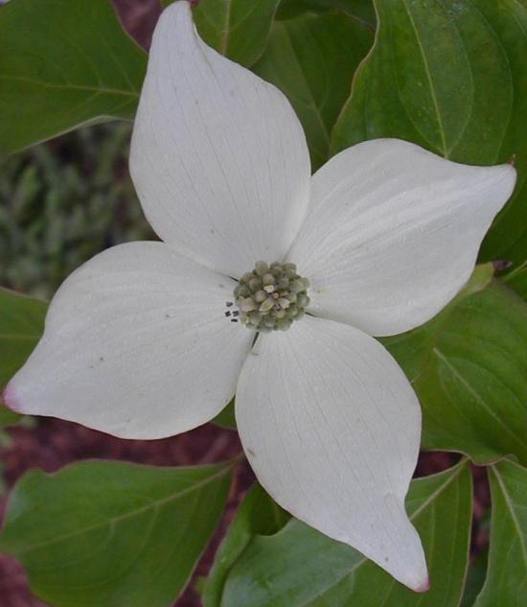
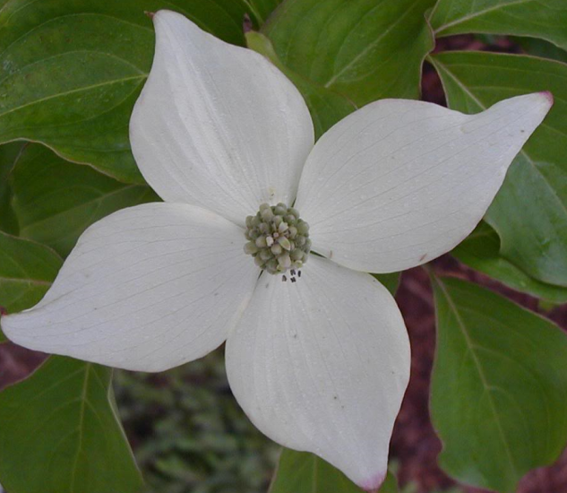
Exercise 2: What’s that Reflection?: Animal Symmetry
For example, if we rotate the dogwood flower pictured below about its center by 90° (π/2 radians), it will look just like it did before we rotated it.
Radial symmetry is often seen in organisms (such as cnidarians like corals and sea anemones) with a sessile life style (that are anchored and cannot exhibit directed movement). Radial symmetry permits these animals to respond to stimuli received on any side.

Slide 39
Finding the Degree Measure of
Rotation of Radially Symmetrical Objects
Look at the circle on your paper, and think about the following questions:
  If the x-axis and y-axis divide the circle into four quadrants, how many degrees of the circle are in one of the quadrants on the graph?
  Looking at just one of the quadrants on your graph and thinking about the number of degrees in that one quadrant, how many degrees does one-half of that one quadrant represent? Click to see the answers!
If your answers to the previous questions were that one quadrant contains 90 degrees of the circle, and that one half of a quadrant represents 45 degrees, you are exactly right!
Now, you will use the square object you used in the previous illustration of rotational symmetry to see how you can quantify the degree of rotational symmetry possessed by an object.

Slide 40
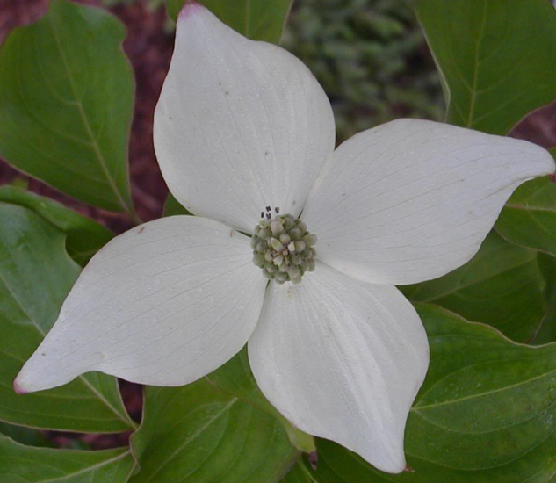
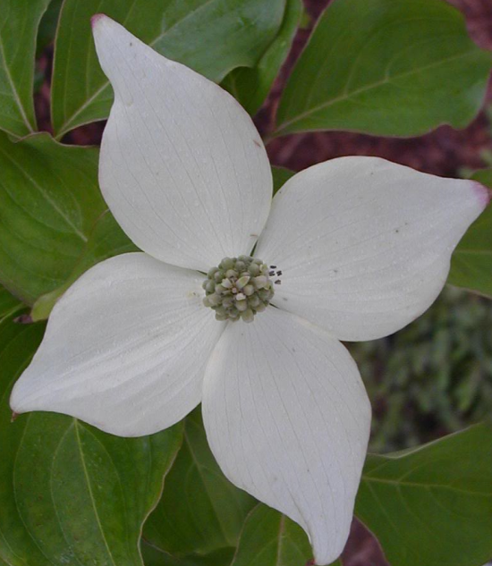
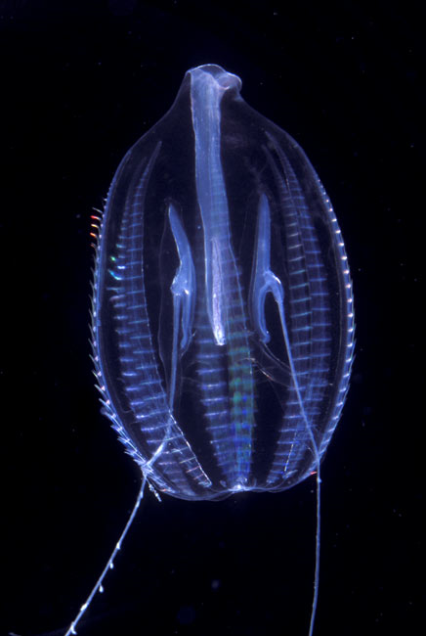
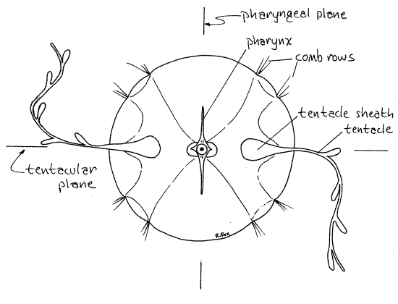
Exercise 2: What’s that Reflection?: Animal Symmetry
Q1. How many rotational positions preserve the appearance of the dogwood flower? What are those positions, in terms of angles? Click for the answer!
Below is an illustration of all of the rotations that preserve the flower’s appearance.
Q2. How many rotational positions preserve the appearance of the comb jelly or sea walnut shown below? Click for answer!
Rotated 90° from original position
Rotated 180° from original position
Rotated 270° from original position
A rotation of 180º preserves the appearance of the comb jelly (as does a rotation of 360º, which brings it back to its original position).

Slide 41
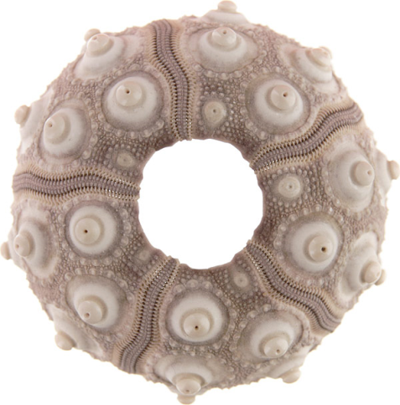
Exercise 2: What’s that Reflection?: Animal Symmetry
Q3. Find all of the angles of rotation less than 360° that preserve the appearance of the sea urchin skeleton below.
Click for the answer!
72°
144°
216°
288°

Slide 42
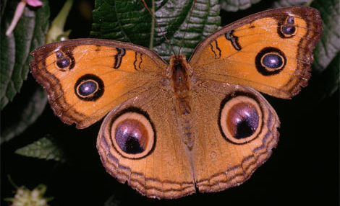
Exercise 2: What’s That Reflection?: Animal Symmetry
The butterfly pictured below also displays symmetry, but of a different type.
The butterfly is symmetrical, because if we draw a line down the middle of this butterfly, the left and right sides of the line look the same, only they are facing opposite directions.

Slide 43
Exercise 2: What’s That Reflection?: Animal Symmetry
This type of symmetry, in which an organism has mirror-image left and right sides is called bilateral or reflection symmetry.
Organisms that are bilaterally symmetrical can only be divided into two equal halves (right and left) by one plane of symmetry.
Bilateral symmetry in animals is associated with a more active lifestyle, in which individuals need to exhibit directed movement towards and away from various stimuli.
  For instance, predators need to follow prey, and prey need to move away from predators.
Bilateral symmetry is associated with the concentration of nerve cells at the anterior end of the body in the form of a brain.

Slide 44
Illustrating Bilateral Symmetry
Take a sheet of paper and fold it in half.
With the paper folded in half, cut out a shape.
After you have cut the paper, open the folded paper.
Notice the fold line going through the middle of your shape.
The fold line on your object is a line of symmetry. You have just created a shape that has bilateral symmetry, because it has two sides that can be folded one onto the other along the fold line without any gaps or overlaps.
This type of symmetry is also called mirror symmetry, because one side is a mirror image of the other.
If you were to stand a mirror along your fold line with the mirror facing you, the image of your shape that you see in the mirror will look like the other side of your shape.
The two sides are the same, but face different directions.

Slide 45
Exercise 2: What’s That Reflection?: Animal Symmetry
Q4. Does the dogwood flower also have reflection symmetry? If so, how many planes of symmetry does the dogwood flower have? Click for the answer!
Yes. The dogwood flower also has reflection symmetry, with four planes of symmetry(two dividing opposite pairs of petals in half, and two passing between adjacent petals).

Slide 46
Exercise 2: What’s that Reflection?: Animal Symmetry
Now separate the animals in the box according to the type of symmetry that they display:
  bilateral symmetry
  radial symmetry
  no symmetry (asymmetrical)
If an organism displays radial symmetry, note how many planes of symmetry are present.

Slide 47
Exercise 3: Guess that Phylum
This exercise presents students of all grade levels with an interactive matching game that helps them learn how to distinguish the nine major animal phyla, using actual organism specimens from each of them.
In this exercise, students will become familiar with the characteristics/traits that are used by scientists to place animals into groups based on traits they share in common.
Click to go to the version for lower grades.
Click to go to the version for higher grades.

Slide 48
Exercise 3: Guess that Phylum (lower grades)
Divide the class into groups of 3-4 students each.
Each group should examine all of the organisms in the box spread out on a table at the front of the room. Students should try to identify similarities and differences between organisms as they examine them, as this will assist them in the game.
Randomly determine the order in which each team will take their turns (you could use the provided spinner to do so).
For each turn, click one of the links on the next slide to display one of the picture groups of an animal phylum (this could also be determined randomly with the spinner, by either the teacher or a team member).
Students in the selected team should examine the organisms in the pictures, and try to see if they can find an organism from the box that belongs to that animal phylum.

Slide 49
Exercise 3: Guess that Phylum (lower grades)
Once a team has presented its decision to the class, see if the other teams agree.
Check the team’s decision, and lead a discussion of why a wrong choice might have been made.
Repeat the previous steps for each of the remaining animals in the sample set.
If students are readers, the teacher may also wish to have them to look over the additional information about each of the animal phyla on the backs of the picture sheets, or to share additional information from these sheets after a review of all phyla has been completed.

Slide 50
Exercise 3: Guess that Phylum
Links to picture groups of the animal phyla:
  Phylum Annelida
  Phylum Arthropoda
  Phylum Chordata
  Phylum Cnidaria
  Phylum Echinodermata
  Phylum Mollusca
  Phylum Nematoda
  Phylum Platyhelminthes
  Phylum Porifera
Click the icon on each phylum’s page for information on that phylum.
Each phylum’s page also has a link back to this page (use the “lower grades” version).
Once you have gone through all the phyla, you can click the “higher grades” link for a table of answers providing specimen IDs and phyla.

Slide 51
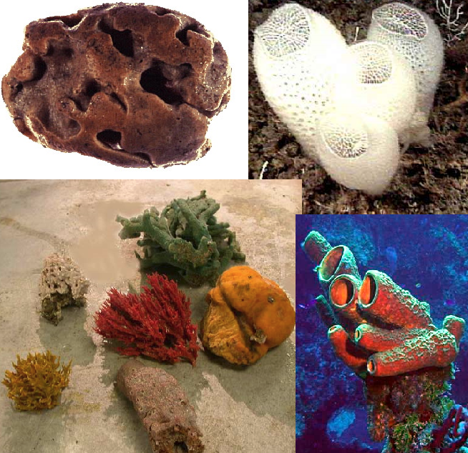
Phylum Porifera
Back to version for lower grades
Back to version for higher grades

Slide 52
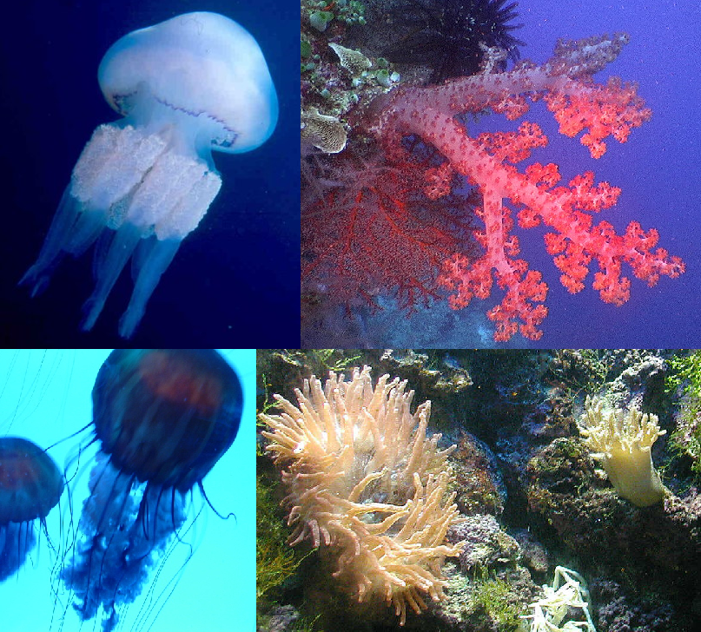
Phylum Cnidaria
Back to version for lower grades
Back to version for higher grades

Slide 53
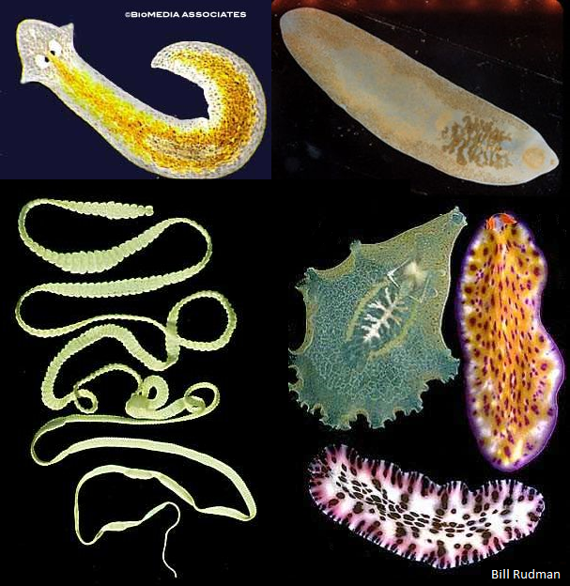
Phylum Platyhelminthes
Back to version for lower grades
Back to version for higher grades

Slide 54
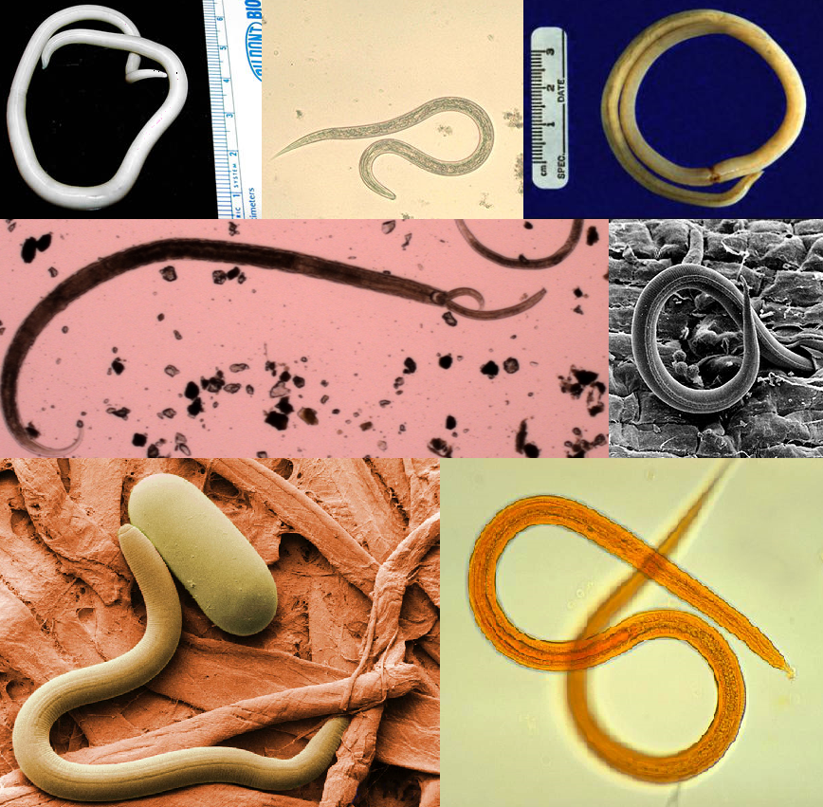
Phylum
Nematoda
Back to version for lower grades
Back to version for higher grades

Slide 55
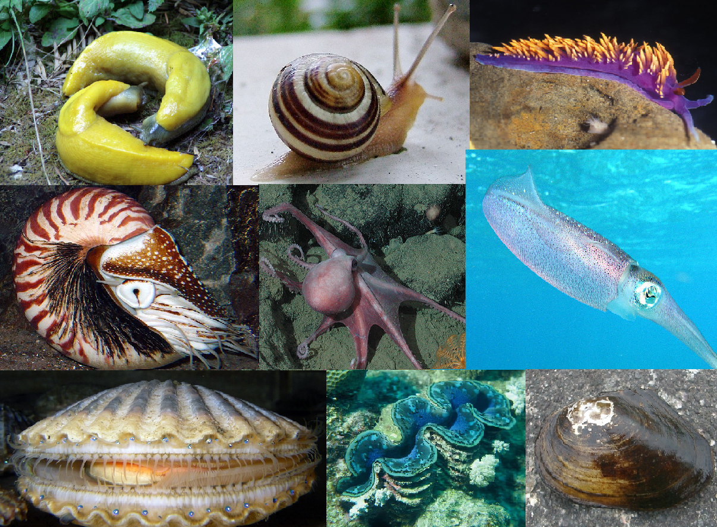
Phylum Mollusca
Back to version for lower grades
Back to version for higher grades

Slide 56
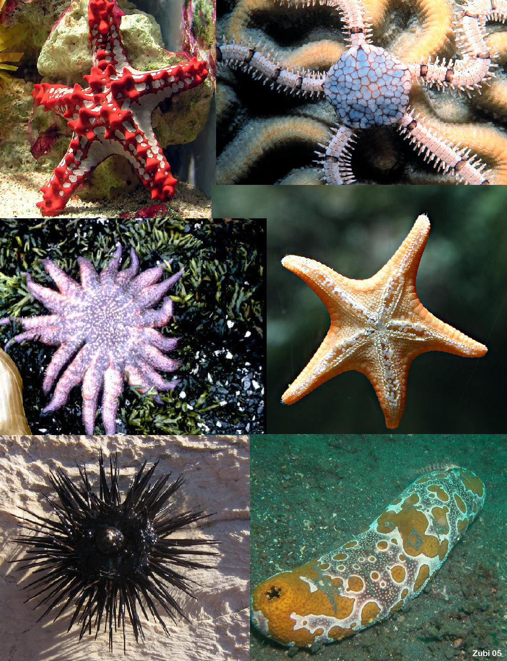
Phylum
Echinodermata
Back to version for lower grades
Back to version for higher grades

Slide 57
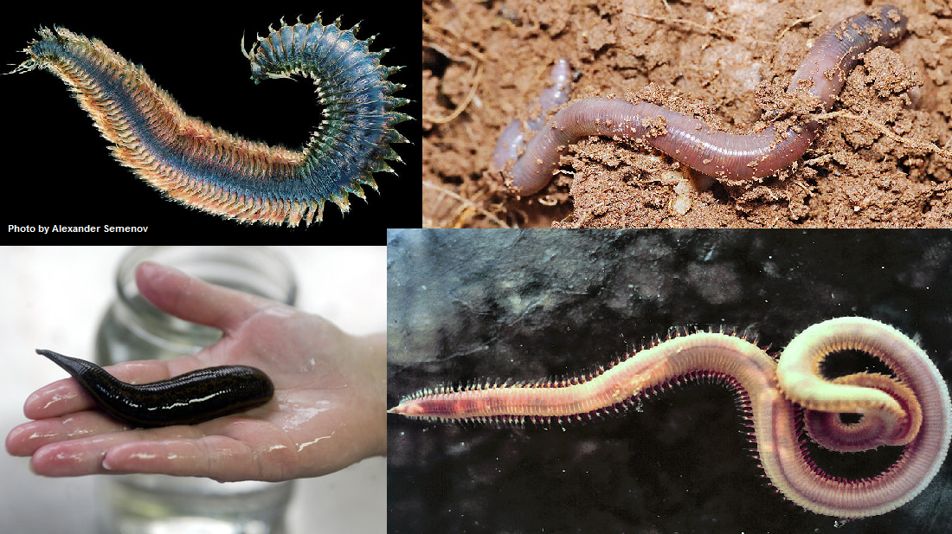
Phylum Annelida
Back to version for lower grades
Back to version for higher grades

Slide 58
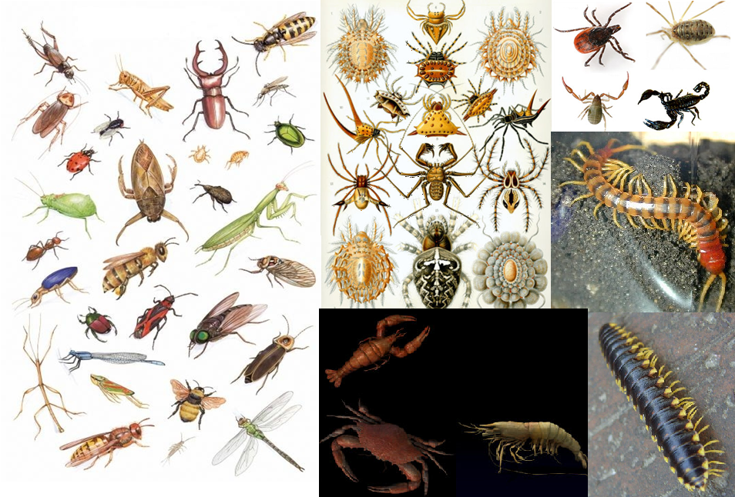
Phylum Arthropoda
Back to version for lower grades
Back to version for higher grades

Slide 59
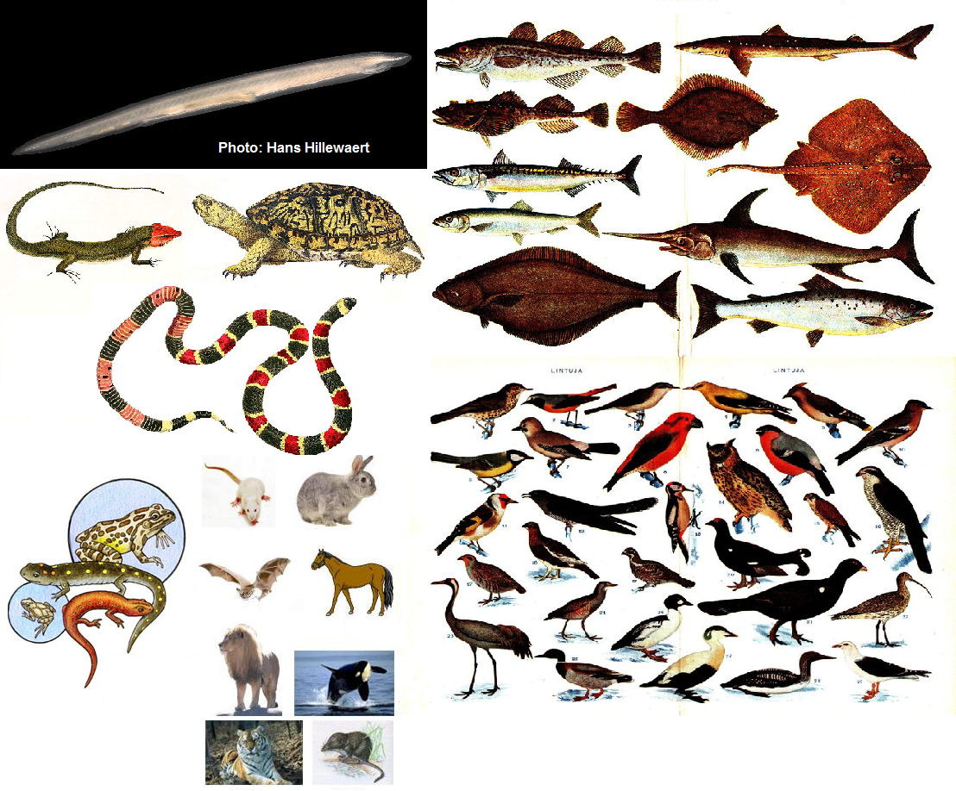
Phylum Chordata
Back to version for lower grades
Back to version for higher grades

Slide 60
Exercise 3: Guess that Phylum (higher grades)
Divide into teams of no more than 4 students each.
Examine the animals at the stations around the room, making notes about their structure. How are they alike? How are they different? Record your observations on a sheet of paper. Your team will use these notes to play the game described below.
For each turn, each team should spin the spinner. Click to consult the table. If the arrow lands on a number between 1 and 9, you will read the corresponding description of the basic body plan of an animal phylum.
Using the information from the table, as well as your notes, decide (as a team) upon an organism that you believe belongs to that particular phylum, and place this animal in the appropriate labeled area in the central station.

Slide 61
Exercise 3: Guess that Phylum (higher grades)
Your team should also present to the entire class what organism they have selected, and their reasoning for selecting that particular organism as a representative of the phylum indicated by the spinner.
A scribe should keep track of which organism (by specimen #) each team has selected to belong to a particular phylum, and write this information on the blackboard.
The next team should then take their turn, repeating the previous step.
Once all of the organisms of a particular phylum present have been taken, a team landing on that phylum loses its turn.
If a team gets a result of 0 on the spinner, they may choose to either spin again to obtain a new phylum, or take an organism another team has assigned to a phylum, if they feel it belongs in a different phylum.

Slide 62
Spinner Result | Phylum and Basic Body Plan
0 | SPIN AGAIN OR STEAL!
1 | Phylum Annelida: Elongated body comprised of many similar segments
2 | Phylum Arthropoda: Body composed of several main regions (each of which may be made up of multiple fused segments); covered with a protective exoskeleton; possess paired jointed appendages
3 | Phylum Chordata: Organisms that possess all of the following at some point in their development: gill slits, a notochord (a flexible, rod-shaped “support system”), a dorsal hollow nerve cord, and a tail that extends past the anus
4 | Phylum Cnidaria: Sac-like bodies which may take one of two basic forms: a free-swimming umbrella-like shape or a tube-like sessile form; both with tentacles with stinging cells
5 | Phylum Echinodermata: Adults display radial (rotational) symmetry; unsegmented; covered with a hard exoskeleton often with a spiny/bumpy surface
6 | Phylum Mollusca: Soft yet muscular bodies that may also possess an internal or external shell
7 | Phylum Nematoda: Cylindrical/tubular bodies tapered at both ends, with openings of the digestive tract at each end; covered with a resistant cuticle
8 | Phylum Platyhelminthes: Flattened, non-segmented bodies that display bilateral (reflection) symmetry
9 | Phylum Porifera: Asymmetrical organisms that resemble a tube closed at one end, with many small perforations (holes) in the body wall
Back to the rules
After the game

Slide 63
Exercise 3: Guess that Phylum (higher grades)
Once all of the organisms have been assigned to the various phyla, now you are ready to find out how each team did!
Consult the answer sheet on the next slide. The scribe should denote the correct answers on the blackboard, and each student should take notes of the organisms in the box that actually belong to each phylum.
After the game, you should engage in a brief class discussion. Consider the questions on the following slide to help get you started.
Look over the study sheets for each phylum, and, if time permits, play the game again to see if you can improve your score and your strategy!

Slide 64
Exercise 3: Guess that Phylum (higher grades)
Questions to facilitate discussion:
  Were there any organisms that were difficult to assign to a particular phylum? Why do you think this was the case?
  Which phylum was the easiest to identify? What features of the organisms in the box made it clear that those organisms belonged to that particular phylum?
  Were there any organisms that were incorrectly assigned to a phylum by a team at any point? If so, what characteristics about those organisms made it tricky to assign them to a particular phylum?
  Were there any phyla that were difficult to distinguish from one another? Why?

Slide 65
Exercise 3: Guess that Phylum
Specimen ID Answers
# | Organism | Phylum | Images | Info | # | Organism | Phylum | Images | Info
1 | Sponge | Porifera |  |  | 13 | Leech | Annelida
2 | Jellyfish | Cnidaria |  |  | 14 | Planaria | Platyhelminthes
3 | Liver fluke | Platyhelminthes |  |  | 15 | Coral | Cnidaria
4 | Roundworm | Nematoda |  |  | 16 | Arachnid | Arthropoda
5 | Clam | Mollusca |  |  | 17 | Earthworm | Annelida
6 | Bristle worm | Annelida |  |  | 18 | Tapeworm | Platyhelminthes
7 | Crustacean | Arthropoda |  |  | 19 | Fish | Chordata
8 | Starfish | Echinodermata |  |  | 20 | Sea urchin | Echinodermata
9 | Lancelet | Chordata |  |  | 21 | Snail | Mollusca
10 | Insect | Arthropoda |  |  | 22 | Myriapod | Arthropoda
11 | Cephalopod | Mollusca |  |  | 23 | Sea squirt | Chordata
12 | Hydra | Cnidaria

Slide 66
Phylum Porifera - Sponges
The first multicellular animals.
Range from a few millimeters to over a meter in diameter.
Larvae swim briefly when they hatch, but settle down and attach to a surface, where they remain for the rest of their lives.
Basic body plan is a tube, open on one end, with numerous pores in the body wall.
Do not have a nervous system.
Feed on bacteria and organic matter such as plankton via filter feeding (though some are carnivorous).
No true tissues, but have several major types of cells (see next slide).
Most sponges are also supported by fibers of a tough protein called spongin. The specimen in your box is a “natural sponge” that is only the spongin fiber remains of a sponge that was once alive.

Slide 67
Phylum Porifera - Sponges
Boundary cells (pinacocytes) – anchor the sponge in place, & may secrete components of the exoskeleton
Amoeboid cells (amoebocytes) – slither around and distribute food
Sclerocytes – secrete calcium carbonate or silica (the same material as sand/glass), which forms spike-like structures called spicules that provide support & protection for the sponge.
Pore cells (porocytes) – tube-shaped cells that allow water to enter the central chamber of the sponge
Collar cells (choanocytes) – Have a single flagella surrounded by a sticky collar. The flagella whips around and creates a current, which brings in food, which gets stuck on the collar, and either digested by the collar cell, or distributed by the amoeboid cells.
Most sponges are also supported by fibers of a protein called spongin. The specimen in your box is only the spongin fiber remains of a sponge that was once alive.

Slide 68
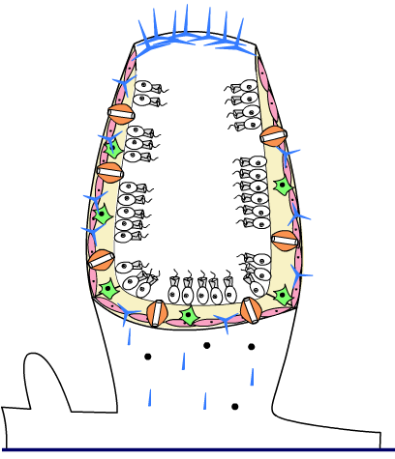
Phylum Porifera - Sponges
For an excellent diagram of cell types and video of how sponges feed, go to http://www.biology.ualberta.ca/courses.hp/zool250/animations/Porifera.swf
pinacocyte
amoebocyte
porocyte
choanocyte
spicule
Back to version for lower grades
Back to version for higher grades

Slide 69
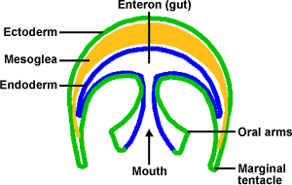
Phylum Cnidaria- Jellyfishes, hydra, corals etc.
First organisms to have tissues.
  Ectoderm (outer)
  mesoderm (middle)
  endoderm (inner)
Phylum can be recognized by its stinging cells called nematocysts.
  Ectodermal and are continuously produced as they are used to kill prey and defend the animal.
Endoderm lines the digestive cavity.
Mesoderm is only present as buds or globs (mesoglea) between the other two layers.
  Gives the Cnidaria shape & gives jellyfish buoyancy.

Slide 70
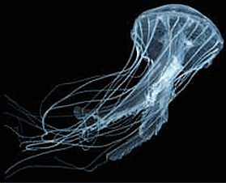

Phylum Cnidaria- Jellyfishes, hydra, corals etc.
Cnidarians exhibit two main body forms:
  the polyp form, which is sessile (attached to a surface with tentacles directed upwards),
  the medusa form, which is a free-swimming, umbrella-like shape, with the tentacles directed downwards.
All are radially symmetrical organisms.
Have a simple nerve net, rather than a complex nervous system. This allows them to make pulsing contractions, but no directed movement.
Floating medusa
Anchored polyp
Back to version for lower grades
Back to version for higher grades

Slide 71
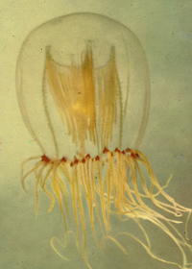
#2 - Jellyfish
The adult jellyfish has a medusa body shape, named after the Greek myth about Medusa, a monster who had snakes for hair, because of the snakelike appearance of the tentacles.
The largest jellyfish has a body that is 2.5 meters in diameter with tentacles that are 36.5 meters long.
Most jellyfish are marine animals that live in salt water which better supports their floating bodies.
The largest species of jellyfish are located in cold waters.
Back to version for lower grades
Back to version for higher grades

Slide 72
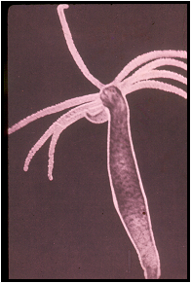
#12 - Hydra
Hydras are found in both marine and fresh water.
They exhibit the polyp body form.
Like other polyps, hydra may contract and shrink in size in response to adverse stimuli.
The hydra gets its name from the Hydra in Greek mythology, because their waving tentacles resemble the multiple heads of the mythological beast from which they get their name.
Back to version for lower grades
Back to version for higher grades

Slide 73
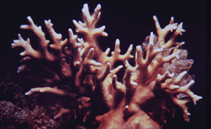
#15 - Coral
Corals are cnidarian polyps which live in colonies.
This box contains the calcium carbonate exoskeleton of a coral colony.
Each hole in the stone-like skeleton once contained a living individual polyp.
Algae (plant-like organisms) help the coral polyps to build these skeletons.
Each species of coral builds a unique skeletal shape, and many types of corals (such as star corals, fire corals, staghorn corals, finger corals, etc.) are named for the shapes formed by the exoskeletons secreted by their colonies.
Back to version for lower grades
Back to version for higher grades

Slide 74
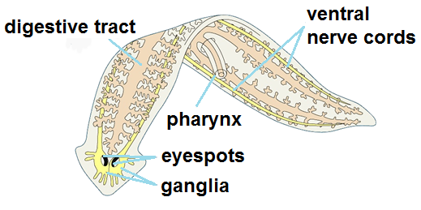
Phylum Platyhelminthes - Flatworms
Three clearly defined cell layers (ectoderm, endoderm, and mesoderm).
Do not possess a body cavity, but were the first organisms to possess organs.
These organs are simple kidneys called nephridia and, like all organs, are composed of mesodermal tissue.
No respiratory or circulatory system - all gas exchanges occur via diffusion through the skin. Paper-thin bodies ensure that all cells are bathed in oxygen.
Because of these limitations, many flatworms are parasitic, & feed off the nutrients produced by other organisms.

Slide 75
Phylum Platyhelminthes - Flatworms
Also have a more advanced nervous system that features a concentration of nervous tissue in the head region. This is known as cephalization.
Bilateral body symmetry (distinct right and left sides).
These two traits facilitate directed movement towards and away from stimuli, an important advance in early animal evolution.
Back to version for lower grades
Back to version for higher grades

Slide 76
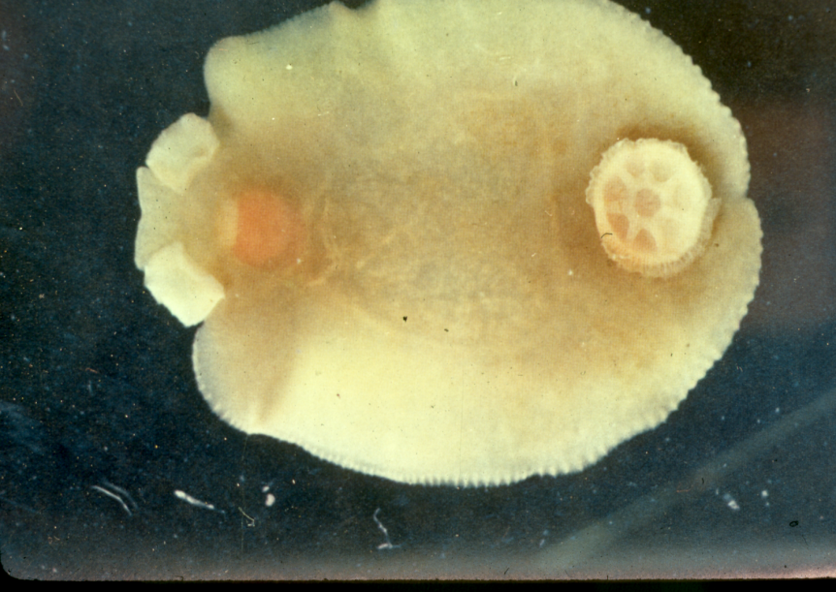
#3 - Liver Fluke
The flukes are parasites.
Most flukes have large sucker-like mouthparts that they use to attach themselves to their hosts.
The animal pictured here is a swordfish fluke.
Your specimen has a white central area that is full of reproductive organs.
Parasites are often capable of producing thousands of offspring.
Back to version for lower grades
Back to version for higher grades

Slide 77
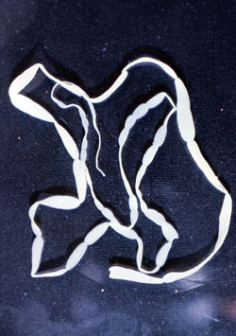
#18 - Tapeworm
Your specimen is a tapeworm from a dog.
All tapeworms spend their adult lives as parasites in the guts of their primary host animals, but may also have intermediate hosts.
Intermediate hosts are organisms that may carry the immature parasite in their bodies, and in which the parasite completes a particular life stage.
However, it is in the primary host where the parasite reaches maturity and reproduces.

Slide 78
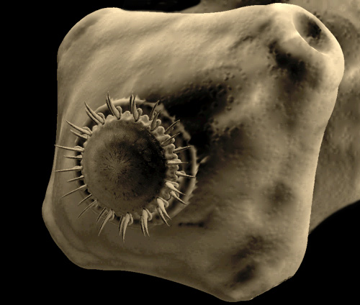
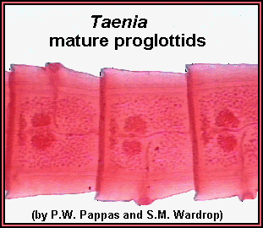
#18 - Tapeworm
Tapeworms have a knoblike head, or scolex, with hooks for attaching to the intestinal wall of the host
A chain of flat, rectangular body segments, or proglottids may reach 20 ft.
Each proglottid contains both male and female reproductive organs. Mature proglottids near the end contain fertilized eggs.
When these segments break off, they are expelled in the host’s feces, at which point a new host can possibly be infected.
Back to version for lower grades
Back to version for higher grades

Slide 79

#14 - Planaria
The planaria are free-living flatworms, and do not depend on a host.
Some are carnivores (meat eaters), while others are scavengers.
Most live in aquatic habitats.
They are also known for their powers of regeneration. If a planaria is split in half, both pieces are capable of regenerating missing parts to create a complete new planaria.
A single planaria can become two planaria, representing a form of asexual reproduction.
Back to version for lower grades
Back to version for higher grades

Slide 80
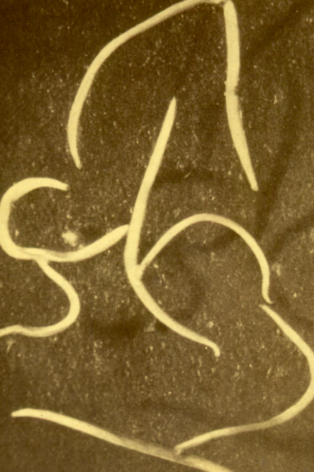
Phylum Nematoda - Roundworms
Most abundant animal phylum in the world, with as many as 1.5 million individuals in a cubic foot of soil.
Found in every habitat imaginable, from soil to marine and fresh water, as well as within other organisms.
Range from 1 mm to several meters.
Approximately 20% are parasitic, though many only live in a particular plant or animal host.
General body plan is a slender, round-body that is tapered at both ends, and covered in a tough, resistant cuticle that protects them from dessication (drying out), from their host’s digestive fluids, or other defenses from their hosts (in the case of parasites).

Slide 81
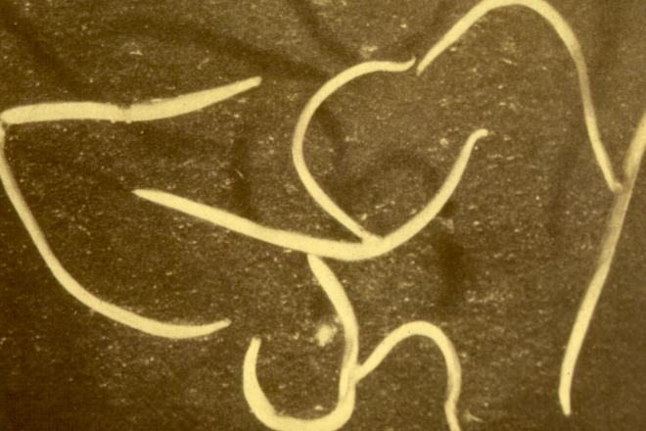
Phylum Nematoda - Roundworms
One of the phyla of pseudocoelomate animals (possess a body cavity surrounding their internal organs that is only lined on the outside with mesoderm).
The worm that can be found encysted in pork is one of the best known, because it causes trichinosis in humans.
Some roundworms are beneficial because they kill agricultural pests.
Use a hydrostatic skeleton to move (opposing muscles acting on a fluid-filled body).
Your specimen is a dog roundworm which steals nutrients from the digestive tracts of dogs.
Back to version for lower grades
Back to version for higher grades

Slide 82
Phylum Mollusca - Molluscs
Mollusca means “soft”, which refers to the soft body of all of these organisms.
However, most mollusks also have a shell, although in the cephalopods (including squid and octopi), it is greatly reduced and internal (though some species of octopus have lost the internal shell entirely.
Like other higher animals, at some phase of their development, mollusks have bilateral symmetry.
This very successful group was even more dominant in the seas before the development of the fishes.

Slide 83
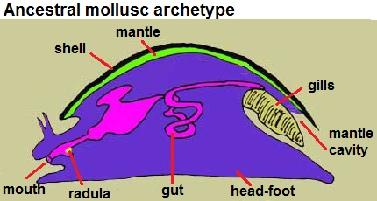
Phylum Mollusca - Molluscs
The picture below is what is considered to be the generalized ancestor of the modern molluscs.
Two features are present: a muscular head-foot, and a mantle cavity where gas is exchanged and waste is excreted.
Modern forms emphasize either
  the mantle cavity (bivalves & cephalopods) or
  the muscular head-foot (gastropods).
There are about 75,000 species in marine, freshwater, and terrestrial forms.
Back to version for lower grades
Back to version for higher grades

Slide 84
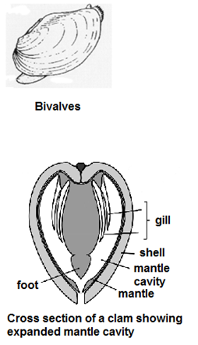
#5 - Clam
Clams belong to the mollusc class Bivalvia (“two valves”), named because their shells consist of two separate valves.
Bivalves use their gills for filter feeding.
In other mollusks, gills are reduced, and only used for gas exchange.
This box contains only one valve of a clam’s shell.
The two halves would have been attached at the narrow dorsal end of this shell.
The mouth and gills would have extended ventrally towards the shell edge, which would have opened to expose them during feeding.
Back to version for lower grades
Back to version for higher grades

Slide 85
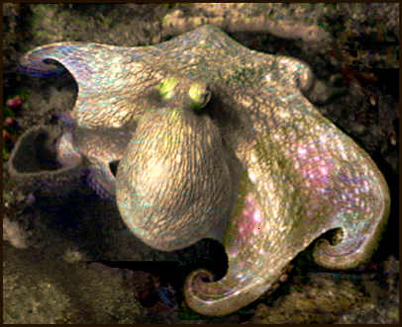
#11- Cephalopod
Most cephalopods do not have an external shell. Instead, they have an internal shell that is greatly reduced (or absent in some species).
An exception is the nautilus, which has an external shell.
Most have suckers on their arms and tentacles, which they use to hold on to their prey.
Cephalopods have keen eyesight and well-developed brains, making them efficient predators.
They can move using jet propulsion by forcing water out of the mantle cavity.
Back to version for lower grades
Back to version for higher grades

Slide 86
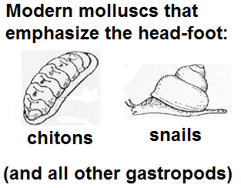
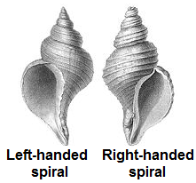
#21 - Snail
Gastropods (class Gastropoda, which includes snails and their relatives) have only one shell (or none in some like slugs and sea slugs).
Many gastropod shells have a spiral form.
Most shells have a right-handed spiral. You can tell if your shell is left or right-handed by holding the shell so that its opening faces you and its apex (the central point where the spiral groove of the shell begins to coil outwards) points up.

Slide 87
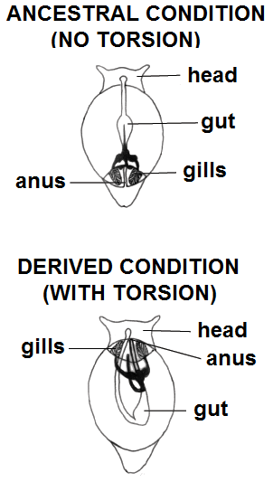
#21 - Snail
A snail shell is asymmetrical, and internally, so is the snail. This is the result of a developmental process called torsion, in which the snail’s organ system is twisted, some organs are lost, and the spiral shell is created.
This may have developed as a defense against predators. This allows the snail to fully retract its head into its shell, thus improving its chances of surviving an attack.
The shells of many mollusks, including snails, follow a mathematical formula known as a logarithmic spiral (see Exercise 9 for details!).
Back to version for lower grades
Back to version for higher grades

Slide 88
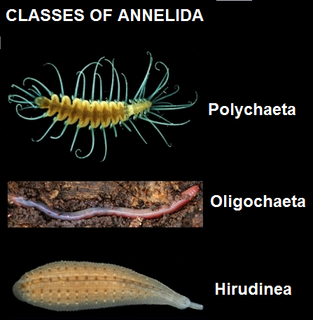
Phylum Annelida – Segmented worms
Annelid worms have flexible bodies divided into many identical segments.
Some ancestral annelids had up to 200 segments. The same muscles, nerves, and even organs are present in each segment. This allows for better directed movements.
Many possess setae (also called chaetae), small bristle-like structures on their segments. These are useful in the burrowing habits of many annelids.
Traditionally, the annelids were classified into three classes (see at right), with information on the next slide.

Slide 89
Phylum Annelida – Segmented worms
Traditional classes of annelids:
  Polychaeta (“many bristles”): a large group of mostly marine worms (with some freshwater and terrestrial species)
  Oligochaeta (“few bristles”); includes the familiar earthworm
  Hirudinea (leeches); lack setae altogether.
Currently, taxonomy of annelids (classification into smaller groups) is a topic of much debate!
Back to version for lower grades
Back to version for higher grades

Slide 90
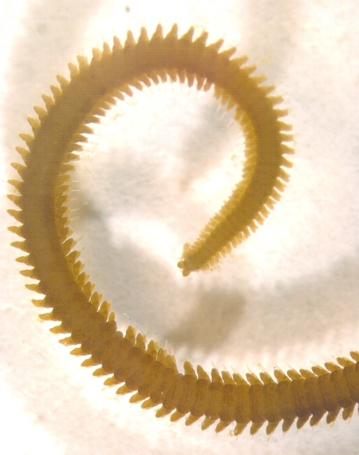
#6 - Bristle Worm
A bristle worm is a member of the mostly marine worm class Polychaeta.
Each segment of the worm has a pair of fleshy limbs called parapodia or ‘almost feet’ that help the worm to crawl along or burrow into the seafloor.
The Polychaeta can also swim in an undulating fashion.
Most polychaetes are predators.
Back to version for lower grades
Back to version for higher grades

Slide 91
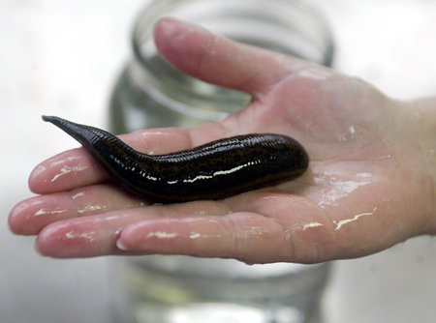
#13 - Leech
Most leeches are parasites that feed on the blood of vertebrates.
Usually have a sucker at the mouth and sometimes at the tail which they use to attach to their host.
The leech that fishermen use as bait is not a parasite, but a scavenger that uses suckers at both ends of its body to attach itself to rocks.
Some species are neither parasites nor scavengers, but predators on small invertebrates.
Were once used to bleed humans when they were sick (thought to rid them of “bad blood”).
Few species are parasitic on humans.
Back to version for lower grades
Back to version for higher grades

Slide 92
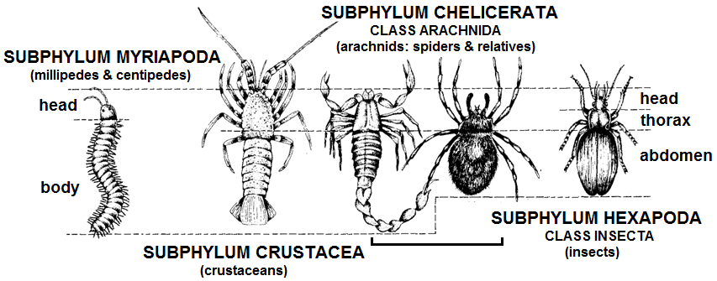
Phylum Arthropoda - Arthropods
Arthropods are specialized, segmented animals.
Fewer segments than annelids, and segments not identical, but specialized to perform specific functions.
Also have a hard exoskeleton for the legs to push against. This eliminates the need for a hydrostatic skeleton.
All have jointed legs.
The exoskeleton does not permit gas exchange through the body surface, so arthropods have a respiratory tube system, though gas exchange is accomplished in most via passive diffusion (no lungs).

Slide 93
Phylum Arthropoda - Arthropods
Back to lower grade version
Back to higher grade version
The most diverse phylum of animals, representing over half of all currently known species on earth!
There are four subphyla within the arthropoda:
  Myriapoda (millipedes and centipedes),
  Crustacea (crabs, shrimp, lobsters, etc.),
  Chelicerata (which includes arachnids, such as spiders and their relatives), and
  Hexapoda, which includes the insects.

Slide 94
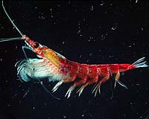
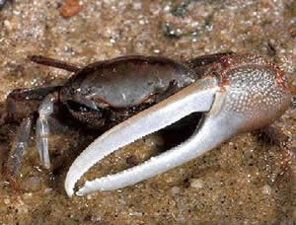
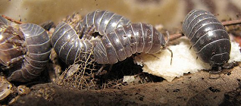
#7 – Crustacean (Subphylum Crustacea)
Members of the subphylum Crustacea are primarily aquatic, though some (including some isopods, or pillbugs, which you may know as “roly polies”) are terrestrial.
Your specimen may be a krill, a small, shrimp-like creature, which plays a key role in Antarctic food webs, a pillbug (a terrestrial isopod), or a small crab.
On your specimen, note the jointed legs, claws and hard exoskeleton, which are all characteristic of the arthropods.
Back to version for lower grades
Back to version for higher grades

Slide 95
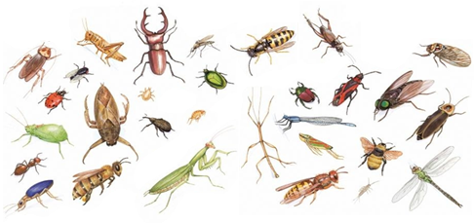
#10 – Insect (Subphylum Hexapoda, Class Insecta)
Insects are the most diverse group of arthropods (and animals overall!), with over a million known species.
The insect’s wings (most adults have them) are responsible for this success: allow them to travel farther to find suitable food & mates.
Examine the wing types to the right.
Do you think the insect in your box belongs to one of these insect orders?
Scientists also use legs and mouthparts in insect identification.
Back (lower grades)
Back (higher grades)

Slide 96
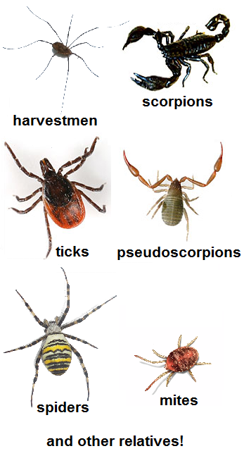
#16 – Arachnid (Subphylum Chelicerata, Class Arachnida)
Arachnids have 4 pairs of legs, 2 pincher-like appendages (chelicerae) with fangs used in subduing prey, and 2 main body segments.
Your specimen may be a spider (order Aranea), a harvestman (order Opiliones, which you may know as a “daddy long-legs”), a scorpion (order Scorpiones), a tick (order Ixodida), or a mite (order Acarina).
Most arachnids use external digestion, sucking liquid meals out of prey after injecting digestive enzymes, but some harvestmen and mites eat solids.
Ticks and many mites are parasites, living on the blood of animal hosts, while some mites suck juices out of plants.
Back to version for lower grades
Back to version for higher grades

Slide 97
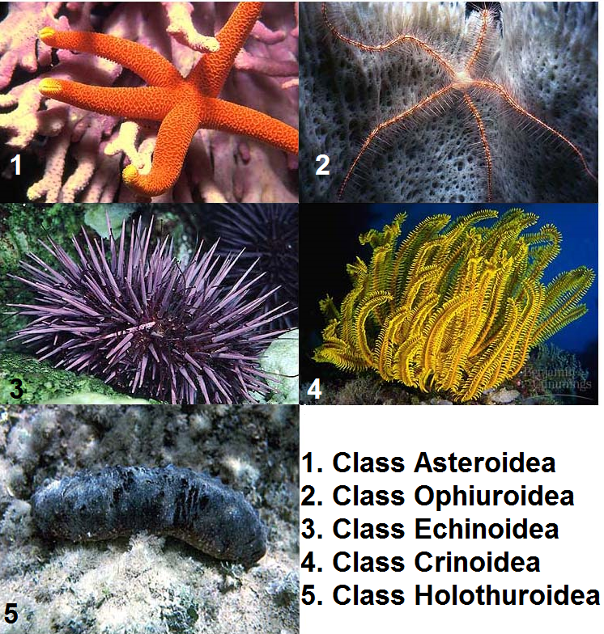
Phylum Echinodermata - Echinoderms
Echinodermata is the phylum most closely related to chordates (including vertebrates like ourselves).
Echinoderms have bony plates in their exoskeletons (“echino-” means “spiny”, and “-derm” means “skin”).
Larvae have bilateral symmetry, like all of the advanced animal groups, but adults have radial symmetry.
All echinoderms are marine.

Slide 98
Phylum Echinodermata - Echinoderms
The phylum Echinodermata is divided into 5 major classes:
  Starfish (class Asteroidea)
  Brittle stars (class Ophiuroidea)
  Sea urchins (class Echinoidea)
  Sea lilies/feather stars (class Crinoidea)
  Sea cucumbers (class Holothuroidea)
Crinoids are sessile, while other classes have hydrostatic skeletons and tube feet that allow them to crawl around.
Back to version for lower grades
Back to version for higher grades

Slide 99

#8 – Starfish (Class Asteroidea)
True starfish are distinguished from the brittle stars (class Ophiuroidea) in that their arms are not sharply demarcated from their central bodies.
They also move only through tube feet rather than by wiggling their arms (as do the brittle stars).
The starfish are the largest of all of the predatory echinoderm classes.
They use their tube feet (which can be seen in the picture on the right) to pry open clams, which are their preferred food items.
Some starfish can extrude part of their stomachs through their mouths in order to digest food outside of the body.
Back to version for lower grades
Back to version for higher grades

Slide 100

#20 – Sea Urchin (Class Echinoidea)
Sea urchins and sand dollars (class Echinoidea) do not have arms, but only a central disk.
Urchins are browsers that use a conveyor belt-like apparatus called a radula to scrape algae off rocks.
The specimen you have lacks protective spines because it is only the calcareous skeleton, or test, of a sea urchin.
The test clearly exhibits the radial symmetry of the echinoderm.
In the living specimen, a spine would extend out of each pimple on the test.
Back to version for lower grades
Back to version for higher grades

Slide 101
Phylum Chordata - Chordates
At some stage in their life cycle, all of the chordates have the following characteristics:
  a dorsal hollow nerve cord
  a flexible skeletal rod called a notochord
  pharyngeal gill slits
  a post-anal tail
The phylum Chordata is divided into three main subphyla:
  subphylum Urochordata (the sea squirts and tunicates)
  subphylum Cephalochordata (the cephalochordates, including lancelets, sometimes called amphioxus)
  subphylum Vertebrata (animals with vertebrae, or a “backbone”)
Back to version for lower grades
Back to version for higher grades

Slide 102

#9 – Lancelet (Subphylum Cephalochordata)
Cephalochordates look like fish, but are actually not.
The lancelet, or amphioxus (which means “pointed at both ends”), is a filter-feeder that burrows in shallow marine waters, using its notochord to aid in burrowing.
Gills are used to collect small food particles from the water.
Once were regarded as the closest non-vertebrate relatives of vertebrates, but newer evidence suggests that the tunicates (subphylum Urochordata) are vertebrates’ closest relatives.
TOO ADVANCED TO HAVE GIVEN RISE TO VERTEBRATES!
Back to version for lower grades
Back to version for higher grades

Slide 103

#19 – Fish (Subphylum Vertebrata, Class Osteichthyes)
Fish are representatives of the vertebrates.
Vertebrates are chordates that protect their hollow dorsal nerve cord with ectodermal bones as a segmented skeleton.
In some vertebrates, pelvic & pectoral girdles provide support to the limbs.
In most vertebrates, the notochord is only present during embryonic development.
Vertebrates are successful because they have many skeletal adaptations.

Slide 104

#19 – Fish (Subphylum Vertebrata, Class Osteichthyes)
Fish have two adaptations that serve them well: lateral (side) fins allow them to swim more quickly and turn more sharply than early vertebrates or non-vertebrate chordates.
Fish can breathe while stationary by moving a protective flap (operculum) over their gills.
Your specimen is a member of the class Osteichthyes, or the bony fish.
Sharks and their relatives are members of the class Chondrichthyes, whose skeletons are made up of cartilage instead of bone.

Slide 105
Vertebrate Classification
Traditional vertebrate classes
  Agnatha – jawless fishes
  Chondrichthyes – cartilaginous fishes (sharks & relatives)
  Osteichthyes – bony fishes
  Amphibia – amphibians (frogs, toads, salamanders, & caecilians)
  Reptilia – reptiles (lizards, snakes, turtles & tortoises, crocodilians)
  Aves – birds
  Mammalia – mammals
Many scientists use a different classification system, because some “traditional” groups don’t contain all descendants of a common ancestor.
If we used groups that contained all a particular ancestor’s descendants, birds should be grouped with reptiles!
Back to version for lower grades
Back to version for higher grades

Slide 106
Exercise 4: Diagram those Traits
You can construct a Venn diagram to show how animal traits are related.
A Venn diagram looks like a rectangle with some circular regions in it. The rectangle represents a set of possible items. In our case, the rectangle will represent all animals.
The circular regions represent items or sets of items in the total set.
In this diagram, one circle represents animals with bilateral symmetry, & the other represents animals with a hydrostatic skeleton.
If two regions overlap, then some things belong to both regions. The overlap in this diagram represents animals with both bilateral symmetry and a hydrostatic skeleton.
bilateral symmetry
hydrostatic skeleton

Slide 107
Exercise 4: Diagram those Traits
Regions that have nothing in common will be separate.
On the other hand, if all things in region A also belong to region B, then region A will be completely contained in region B.
Finally, the size of a region does not indicate how many things belong to the region.
The fact that the hydrostatic skeleton region is about the same size as the bilateral symmetry region in this diagram does not mean that there are about as many animals with hydrostatic skeletons as animals with bilateral symmetry.
bilateral symmetry
hydrostatic skeleton

Slide 108
Exercise 4: Diagram those Traits
Use the Study Sheets to the Animal Phyla to answer the following questions:
Q1. Which of the following animals belong in the region of overlap?
    Hydra
    Roundworm
    Insect
Q2. Which of the following animals belongs in the solid blue region?
    Hydra
    Roundworm
    Insect
bilateral symmetry
hydrostatic skeleton

Slide 109
Exercise 4: Diagram those Traits
Q3. Draw a Venn diagram with regions to represent animals with the following traits: jointed legs, radial symmetry, nervous system, tissues. Which of these regions contains the most animals?
bilateral symmetry
hydrostatic skeleton

Slide 110
Exercise 4: Diagram those Traits
Q4. Several pairs of regions are listed below. Use the diagram to decide which member of the pair contains the most animals, or else state that this cannot be determined by looking at the diagram.
  radial symmetry or nervous system
  jointed legs or radial symmetry
  nervous system or jointed legs
Now pick some traits that interest you, and construct a Venn diagram to show how they are related.
bilateral symmetry
hydrostatic skeleton
Do not move ahead until you have completed these questions.
Answers can be found on the following slides.

Slide 111
Exercise 4: Diagram those Traits
Q1. Which of the following animals belongs in the region of overlap?
    Hydra
    Roundworm
    Insect
Q2. Which of the following animals belongs in the solid blue region?
    Hydra
    Roundworm
    Insect
bilateral symmetry
hydrostatic skeleton

Slide 112
Exercise 4: Diagram those Traits
Q3. Draw a Venn diagram with the following regions: jointed legs, tissues, nervous system, radial symmetry. Which of these regions contains the most animals?
The region labeled tissues contains the most animals because all of the other regions are contained in this region.
nervous system
jointed legs
radial symmetry
tissues

Slide 113
Exercise 4: Diagram those Traits
Q4. Use the diagram to decide which member of the pair contains the most animals, or if this cannot be determined from the diagram.
nervous system
jointed legs
radial symmetry
tissues
radial symmetry or nervous system:
cannot be determined from the diagram
jointed legs or radial symmetry:
cannot be determined from the diagram
nervous system or jointed legs:
nervous system

Slide 114
Exercise 5: Sort these Animals
This exercise provides a framework in which younger students (grades K-2) can explore the similarities and differences among the major animal phyla.
This exercise incorporates elements from both the “Diagram Those Traits” and “Relatives of Relatives” exercises for older students.
Teachers may use one of two approaches (identity-based or trait-based) to introduce the concepts of classification, as well as relationships among groups of animals, both involving interactive, teacher-mediated discussion.
The class might complete the exercise based on identities first and then try it using traits as a mechanism of formative assessment of what they have learned. An open-ended exploration of the topics is also presented.
Materials Needed: Animal specimens from this box, tape

Slide 115

Exercise 5: General Instructions
Use tape to mark out the rectangles diagrammed below either on a table or on the floor. Approximate suggested sizes for each rectangle are provided. Label each of the rectangular areas with a letter, as shown.
Either randomly assign a specimen from the box to each student in your class, or allow each student to come up and select an organism from the box. If you have more students than specimens, you may wish to have students pair up to share an organism.

Slide 116
Exercise 5: General Instructions
After all the specimens have been assigned, let students know that biologists like to group similar living things together and think about how different organisms might be related to one another.
You may also wish to mention that very often, things that are closely related look similar to one another, BUT things that look similar may not always be very closely related.
Point out the taped-out diagram (illustrated on the previous slide), and explain that these boxes represent a way of grouping animals based on similarities, and each box represents a trait or characteristic of an animal.
If an animal is inside a box that is inside another box, that animal has the trait(s) represented by each box containing it.
Instructions for both the identity-based & trait-based versions of this exercise, & an open-ended expansion, are on the following slides.

Slide 117
Exercise 5a: Sort these Animals (Identity-based)
Instruct students to look at their specimens and note the number on their specimen. Then, instruct students to place their specimens inside the boxes as follows:
  Box A: specimens 7, 10, 16, & 22
  Box B: specimens 6, 13, & 17
  Box C: specimens 3, 4, 5, 9, 11, 14, 18, 19, 21, & 23
  Box D: specimens 2, 8, 12, 15, & 20
  Box E: specimen 1
After all students have placed their specimens in the appropriate boxes, have them examine the organisms in each box, and try to see if they can figure out the traits that those organisms have in common. Don’t forget, box B also contains box A, and box C contains both boxes A and B! Correct answers are on the next slide.

Slide 118
Exercise 5a: Sort these Animals (Identity-based) Answers
Box A: All have paired jointed legs and a tough exoskeleton.
Box B: The bodies of all of these organisms are comprised of distinguishable segments.
Box C: All of these organisms have bilateral (reflection) symmetry. In other words, a single line could be drawn down the middle of each of these organisms, which would divide them into identical, mirror image left and right halves.
Box D: These organisms all have radial (rotational) symmetry. Another way of explaining this to students is to imagine placing a dot right in the middle of the organism. There are several ways to cut outwards from this center point that would divide the animal into multiple parts that all look the same, much like cutting pieces of a pie.
Box E: This organism is the most different than all the others, as it is not symmetrical in any way, and does not have any of the specialized structures listed above.

Slide 119
Exercise 5b: Sort these Animals (Trait-based)
Mention each of the traits listed for a particular box from the previous slide.
Ask students to examine their specimens, and to place them in that box if they think their organism matches that description.
Go over the students’ choices for each box, and check to see that they are correct.
If there are any incorrect answers, or any organisms left out, let the students know the correct answer, but have them try to figure out why an organism does or does not fit into that box.

Slide 120
Exercise 5c: Sort these Animals (Open-ended Expansion)
Explain to students that different scientists often use different characteristics to categorize organisms into groups.
Allow students to work together in small groups to try to think of alternate ways of grouping together the provided specimens, based on characteristics that they observe (such as size, color, the way the animals would have moved when alive, habitat, etc.).
Have them draw a system of boxes showing how they decided on these groupings.
You could have non-readers draw pictures of their organisms in the appropriate boxes, or print pictures of the organisms for them to cut out and glue in these boxes.

Slide 121
Exercise 6: Who’s in that Tree?
Teachers may wish to consult the workbook for further background information before doing this exercise with students!
The figure on the next slide resembles a tree.
It represents the phylogenetic tree for the nine major phyla in the Kingdom Animalia.
A phylogenetic tree is used to show the historic relationships among a group of organisms.
At the base of the trunk are organisms that appeared first in history
They are the ancestors of other groups of organisms that branch off of the trunk as each gains new characteristics.

Slide 122


Slide 123
This tree demonstrates the idea that new kinds of animals come into existence as modifications appear in existing animals.
As a result, the Animal Kingdom today has over 30 phyla, each with a distinctive body plan.
The major changes in body plan that have occurred over time are noted in the legend on the figure on the previous slide.
Have students examine the phylogenetic tree, noting the different changes in body plan that have occurred with the appearance of new branches.

Slide 124

To understand phylogenetic trees, think about how actual trees grow: from the roots up.
The roots of a tree represent the oldest part of a tree.
Tips of the branches represent the newest parts of the tree.
When you examine a phylogenetic tree from the root to the tips of the branches, you are looking forward in time.
PRESENT
TIME

Slide 125
There are points where two branches arise from a common point on the tree, known as nodes.
A node represents an ancestor of the organisms represented by the branches from that point.
This splitting into branches from an ancestor represents the formation of new groups of organisms from that ancestor.
NOTE: “Ancestor" refers to a population of organisms that gave rise to the different branches from that node!
N
O
D
E
S

Slide 126
On some trees, some nodes are coded with a number, a letter, or other info.
This indicates a trait passed on to descendants.
Once a trait appears at a node, all organisms located on higher branches of the tree have this trait.
For example, the circled node labeled “4" represents a true body cavity (coelom).
All phyla represented that branch off either from or after this point (Mollusca, Arthropoda, Annelida, Echinodermata, and Chordata) thus have a coelom.
Coelomates
(All have a true body cavity, or coelom)

Slide 127

IMPORTANT NOTE: When interpreting phylogenies, it is important to recognize trees with equivalent topologies(the same branching structures).
Trees which have equivalent topologies show the same relationships, but may look slightly different.
On any given tree, switching positions of branches that arise from the same node, or rotating parts of the tree around a node does NOT change the relationships shown by the tree. See below for an example.
In the second tree, the branches representing B & C have just switched places at the node labeled “2” in the first tree. The third tree shows a rotation around the node labeled “1” in the first tree. All still show the same relationships. In other words, all these trees have equivalent topologies.

Slide 128
Exercise 6a: Understanding Historical Relationships
Now that you know how phylogenetic trees work, see if you can determine where the animals in your box go on the tree.
Carefully study Figure 1, noting the changes in body plan that are associated with each branch, and the animal group that is associated with the new feature.
Find the phylogenetic tree poster. The branches are labeled with the traits they represent, but not with the animal group that belongs to the branch.
Lay the poster on a flat surface and place each specimen on the branch where you think it belongs. Do not refer to Figure 1.
Use the key on the next slide to help you place your animals on the tree.
Check your animal positions on the poster against the smaller diagram (Figure 1) and the answer sheet at the end of the book (and/or the study sheets to the animal phyla) when you have finished. How did you do?

Slide 129
KEY (handout)
Branch color | Characteristics shared with ancestors | Characteristics passed up the tree | Additional characteristics
Red |  | multicellular | filter feeding, sessile
Orange | multicellular | tissues (ectodermal & endodermal) | stinging cells, radial body symmetry
Yellow | multicellular, three tissues | bilateral body symmetry, organs | primitive kidneys, thin body
Green | multicellular, three tissues, organs, bilateral body symmetry |  | false body cavity filled with fluid to maintain tubular body-shape
Blue | multicellular, three tissues, organs, bilateral body symmetry | true body cavity that houses organs | shell
Pink | multicellular, three tissues, organs, true body cavity, bilateral body symmetry | mouth end of gut develops first, segmented body | many segments give a “ringed” appearance
Purple | multicellular, three tissues, organs, true body cavity, bilateral body symmetry, mouth end of gut develops first |  | reduced number of body segments, external skeleton and muscled limbs
Gray | multicellular, three tissues, organs, true body cavity, bilateral body symmetry | anus end of gut develops first | larvae are bilaterally symmetrical, but adults can be divided into 5 equal pieces around a central point; external skeleton
Brown | multicellular, three tissues, organs, true body cavity, bilateral body symmetry, anus end of gut develops first |  | Possess all of the following at some point in the life cycle: notochord (“skeletal” support rod), dorsal hollow nerve cord, gill slits, muscular post-anal tail

Slide 130

Exercise 6b. Comparing Trees
There are often many different scientific hypotheses as to how a system functions.
Figure 2 shows two competing hypotheses as to how the higher invertebrates are related to one another. Examine the trees in Figure 2 to see how they are different.
Figure 2. Comparison of two different proposed branching patterns for relationships among animal phyla.

Slide 131

Directions
Find animals that belong to the phyla that are represented in Figure 2.
Compare the lineages shown below in Figures 2A & 2B.
Figure 2A, (based on patterns of animal development) is the one that you have been using thus far. For quite some time, this has been the most widely-accepted hypothesis regarding the relationships amongst the major animal phyla.
The tree in Figure 2B was first hypothesized in 1997 to explain the results of the molecular analysis of one gene system. According to this new tree, animals possessing a cuticle that must be shed during growth are more similar than the animals lacking this cuticle.

Slide 132
Directions
Answer the following questions.
Q1. Which phyla are displaced in the tree depicted in Figure 2B from where they are located in the tree in Figure 2A?
Q2. How might the validity of the two alternative trees be tested?

Slide 133
Answer Time!
Q1. Which animal groups are displaced in the tree depicted in Figure 2B from where they are located in the tree based on development (Figure 2A)?
Click for the answer!
The arthropods have been removed from the lineage containing other groups that have a true coelom (mollusks and segmented) worms and placed into a lineage that includes organisms that have a pseudocoelom and that share the same gene in common, as well as a cuticle.

Slide 134
Answer Time!
Q2. How might the validity of the two alternative trees be tested?
Click for the answer!
One thing that can be done is to examine more genes to determine whether the relationships suggested by the sequencing of one gene are supported by the sequencing of other gene sequences. In fact, a study doing just that was recently published in 2008, and this publication is available on the teacher CD included with this unit.

Slide 135
Exercise 7: What’s that Animal?
In the box, you should find an animal with no number, labeled as the “Mystery Animal”.
Given what you have learned in the other exercises in this unit, place this animal with its nearest relatives on the tree.
To which phylum do you think your mystery animal belongs?
What traits do you notice on your mystery animal that led you to make this decision?
Check your answers on the following slides to see if you were correct.

Slide 136
Exercise 7: What’s that Animal?
Your mystery animal could be a horseshoe crab, which is not a true crab at all.
It is an arthropod in the subphylum Chelicerata, more closely related to the spiders and other arachnids than to the crustaceans.
Sometimes called “living fossils” because their early relatives inhabited the Earth 100 million years before the dinosaurs.
The species Limulus polyphemus reaches 2 feet long & is best known for yearly spawning along U.S. Atlantic coasts, when thousands crowd beaches at high tide.
A female digs a hole & lays thousands of eggs, which the male fertilizes, before both return to sea.
The eggs are important food for shore birds.
If your mystery animal does not look like a horseshoe crab, look at the next slide.

Slide 137

Exercise 7: What’s That Animal?
Your mystery animal could be a sea cucumber, a relative of the starfish and sea urchins (phylum Echinodermata).
Belong to the Class Holothuroidea, & are sometimes called the “earthworms of the ocean floors”. Though not closely related to earthworms at all, they perform a similar role: recycling organic matter.
These slow-moving animals are often buried in the detritus they eat.
Break down animal waste & algae to be further decomposed by bacteria.
Their tube feet are modified into tentacles used to grab organic material.
If attacked, can eject sticky Cuvierian tubules from its anus to entangle predators, & attempt a slow escape.
Of the about1400 species of sea cucumbers, some are served in Chinese restaurants!

Slide 138

Exercise 8: Pass that Gas!
Click the image below to see a clip from the 1957 film The Deadly Mantis, which is a good example of bad science in horror movies.
WHY COULD INSECTS THIS LARGE NEVER EXIST?

Slide 139
Exercise 8: Pass that Gas!
Brainstorm for a while to come up with some possible explanations! Click after everyone has had a chance to think about it.
Example ideas proposed by students:
  Exoskeleton too weak
  When shedding exoskeleton, the insect would collapse under its own weight
  Limits of habitat/dwelling size
  Lung capacity
  Can’t get enough oxygen
Did you come up with any others besides these? Are any of these correct? Let’s move on and find out!

Slide 140
Exercise 8: Pass that Gas!
Test your knowledge: As the radius of a spherically shaped cell increases, the surface area to volume ratio of the cell
  Increases
  Decreases
  Stays the same
  Insufficient information
  Click to move on!
17

Slide 141
Exercise 8: Pass that Gas!
Surface Area/Volume Ratios & Cell Size
nutrients
wastes
For a sphere:
Volume = 4πr³/3
Surface area = 4πr²
Therefore, the ratio of surface area to volume is equal to 3/r. In other words, as cell size (r) increases, this ratio decreases!

Slide 142



Exercise 8: Pass that Gas!
Insect Respiration Mini-Lecture
flatworm
Tracheal tube system
Exoskeleton with waxy cuticle prohibits simple diffusion through epidermis (as seen in other organisms, such as flatworms).
No blood vessels, so no lungs.
Tube system (tracheae) that carries O₂ from surface to cells and takes up CO₂ to be released.

Slide 143
Exercise 8: Pass that Gas!
Real World Data from Beetles
Length of Beetles Tracheal volume
(as % of body volume)
17mm 1.9%
18mm 2.1%
27mm 3.3%
47mm 5.7%
60mm 7.4%
62mm 7.6%
80mm 9.9%
129mm 15.8%
Graph the data and determine the relationship
between tracheal volume and beetle body length.

Slide 144

Exercise 8: Pass that Gas!
Real World Data from Beetles
Now let’s do some math!
Look at the plot you just created.
What does this information tell us about insect size and tracheal system size?

Slide 145
Which mathematical formula below best describes the relationship between these two variables: beetle length and proportion of the volume taken up by breathing tubes? What do the graphs of each of these equations look like?
Exercise 8: Pass that Gas!
Real World Data from Beetles
x² + y² = r²
y = mx + b
y = log(x)
y = 1/x

Slide 146

Exercise 8: Pass that Gas!
Real World Data from Beetles
To the right are graphs of equations of each of the forms below.
x² + y² = r²
y = mx + b
y = log(x)
y = 1/x
The correct answer is B, which describes a line!

Slide 147



Exercise 8: Pass that Gas!
The Problem for Insects
SMALL INSECT
LARGE INSECT
In a large insect, oxygen cannot reach innermost cells quickly enough if tube diameter stays the same!
SOLUTION: Larger tracheole volume to meet O₂ needs!
Examine the straw & larger tube in your box. If you were in a box with no source of air besides one of those connected to the outside world, which would you choose? Why?

Slide 148

Exercise 8: Pass that Gas!
Based on your data, what is the theoretical maximum length of a beetle?
The largest living beetle today actually is 170 mm.
What do you think limits the body volume that an insect can devote to the tracheal system?

Slide 149

Exercise 8: Pass that Gas!
During the Carboniferous (350 mya) there were insects much larger than any found on Earth today.
Develop a hypothesis from this observation.
How would you test your hypothesis?

Slide 150
Exercise 8: Pass that Gas!
The relationship between body length and the % of the body volume taken up by tracheal tubes in beetles is defined by a line with a slope of 0.1226. Even today there are insects much longer than the beetles we examined in this exercise.
Answer the following questions:
If you assume that a maximum volume of tracheal tubes is 20% of total insect volume, and the slope of the relationship between length and tracheal volume is 0.056, what is the maximum length of this insect?
What does this insect look like? Explain your answer.

Slide 151


Exercise 8: Pass that Gas!
Answer: A Walking Stick!
Chan’s Megastick (Phobaeticus chani) is about 360 mm long (twice as long as the largest beetle!)

Slide 152
Exercise 8: Pass that Gas!
Exercise 8 was initially developed at a National Academies Summer Institute by Biology in a Box Director Dr. Susan Riechert and the following additional members of a Biology/Math Interface Team:
  University of Tennessee
    Dr. Randy Brewton
    Dr. Stan Guffey
  George Washington University
    Dr. Ken Brown
    Dr. Hartmut Doebel
  University of Illinois at Chicago
    Dr. Robert Malchow
    Dr. Michael Mueller

Slide 153
Exercise 9: Follow that Spiral!
This exercise contains several sub-exercises within this exercise. Click the links below to check them out!
Introduction: Identifying spirals in nature & man-made products, describing spirals (Grades K-12)
Exercise 9A. Is that Snail Left- or Right-handed?: Investigating a natural phenomenon in gastropod shells.
Exercise 9B. Measure that Shell!: Using morphometrics to quantitatively describe shell shape (Grades K-12)
Exercise 9C. That Mathematical Mollusc: The Nautilus: Exploring logarithmic spiral growth in the nautilus. Contains several sub-exercises for grade levels 2-12

Slide 154

Exercise 9: Follow that Spiral!
How many of the spirals below can you identify?

Slide 155

Exercise 9: Follow that Spiral!
Snails have a spiral shell. Why does their shell have such a structure? Click for the answer!
Snails undergo a process called torsion, in which their organ systems are twisted, as they develop.
This may have developed as a defense against predators.
Torsion allows snails to retract their heads before their tails. If you were a snail, which would you want to save first, your head or your tail?
Is a snail’s shell symmetrical? (Click for answer!)
A snail’s shell does not exhibit bilateral or radial symmetry, but does exhibit scale symmetry, discussed in the exercise on logarithmic spirals.

Slide 156

Exercise 9a: Is that Snail Left-handed or Right-handed?
Are you left-handed or right-handed?
Snails’ shells also exhibit handedness!
Examine the shells in your box.
How many are left-handed?
How many are right-handed?
Left-handed spiral
Right-handed spiral

Slide 157
Exercise 9a: Is that Snail Left-handed or Right-handed?
If you have trouble determining the handedness of your shells, place them in the orientation shown, with the apex up, and the opening towards you.
Place a finger in the groove of the spiral at the apex.
Trace this groove so that you are moving along the spiral path towards the shell’s opening.
If your finger moves in a clockwise path, your snail has a right-handed spiral. If the path your finger traveled was counterclockwise, the spiral of the shell is left-handed.
Left-handed spiral
Right-handed spiral
Why do you think handedness occurs in snail shells? Do some internet or library research to find out!

Slide 158

Exercise 9b: Measure that Shell!
Snails enlarge their shell “house” as they grow.
Growth occurs in a spiral form.
The shell apex represents the oldest part of the shell, formed before the snail hatched.
More whorls are added as the snail grows.
The largest, lowest whorl is known as the body whorl, since it houses the snail’s body.
Examine the other parts of a snail shell to the left.
Try to identify these on your shells.

Slide 159
Exercise 9b: Measure that Shell!
Though all snail shells have a spiral form, they come in different shapes.
Sort your shells into several categories of similar shapes.
Within each shape category, arrange shells from the largest to smallest (based on looks alone).
Using a size-related trait (a list of possibilities is on the next slide), actually measure this trait on each of your shells in each shape group.
Make a table like the one below, and do this for each of your shape groupings.
Rank | Size Measure
1 | 1
2 | 2
3 | 2.5
4 | 3.25
5 | 3.5

Slide 160
Exercise 9b: Measure that Shell!
Possible size measures for your shells
  Number of whorls
  Width and/or height of the aperture (opening)
  Shell height
  Shell width
  Greatest shell circumference
  Shell volume
  Area of the aperture
You are free to measure another size-related trait. Just make sure you do this the same way for all shells!
Your teacher may provide you with additional information or assistance.
Your teacher may also ask you to calculate other size-related traits from a particular measurement.

Slide 161
Exercise 9b: Measure that Shell!
Look at your completed table. Does your original ranking according to apparent size agree with your size measurements? Why might your visual rankings differ than rankings based on your measurements? Click for the answer!
If these rankings do not agree, this could be because your visual rankings may have been based on a particular trait (such as shell length, width, etc.), while the trait you actually measured may have resulted in different rankings. This is because different size measures may or may not be correlated with the trait they used in your visual rankings.

Slide 162
Exercise 9b: Measure that Shell!
By examining the shape of a snail’s shell, what can you learn about its lifestyle, such as
  where it lives
  what it eats
  how fast it moves
  how it defends itself against predators
  etc.
Does the shape of a snail’s shell serve a function, help the snail to accomplish particular tasks?
Is the shape of the shell the result of the environment in which the snail lives?
Do other shell traits, besides shape, give you insight into a snail’s life?
On the next slide, you will be given some ideas on how to explore these questions!

Slide 163

Exercise 9b: Measure that Shell!
Pick a particular aspect of a snail’s lifestyle that interests you.
Think of a few traits that might be related to this aspect that you chose.
On the next slide is a list of traits you may measure. You may also measure any other traits that you think might be important. Again, your teacher may assist you with additional information for these!
Measure these traits for each of your shells, and record this data in tables for each shape group, similar to the one below. Use mm for linear measurements.

Slide 164
Exercise 9b: Measure that Shell!
Possible shell measurements
  Number of whorls
  Width and/or height of the aperture (opening)
  Shell height
  Shell width
  Greatest shell circumference
  Shell volume
  Area of the aperture
  Color variation
  Relative shell height
  Whorl expansion rate
  Shell angle
A helpful link:
http://en.wikipedia.org/wiki/File:Gastropod_shell_measuring.png

Slide 165
Exercise 9b: Measure that Shell!
After you have recorded your data, look to see if the traits you measured are correlated.
  If one trait is usually large when another trait is large, then there is a positive correlation between the traits.
  If one trait is usually small when another trait is large, then there is a negative correlation between the traits.
You may wish to create graphs or plots of your data to help you with this.
If relationships exist between traits, are these relationships similar or consistent among different shape groups?
Why do you think this may or may not be the case?

Slide 166
Exercise 9b: Measure that Shell!
Go to the next slide for an identification guide to your shells.
Identify the species of each of your shells, and add this information in a new column in your tables.
Use the library/internet to research these species. Additional information on these species can also be found in the workbook for this unit. Try to answer the following questions:
  Are the shell traits that you measured related to the lifestyle aspect that you chose to study?
  If so, why might these traits be important?
  How do they relate to your chosen aspect of snail lifestyle?
  If not, can you find other aspects of the snails’ lifestyles that appear to be related to the traits you chose to measure?
Share your results with the rest of the class!

Slide 167








Exercise 9b: Measure that Shell!
Striped Nerite
(family Neritidae)
Lettered Olive
(Oliva sayana)
Moon snails
(family Naticidae)
Nassarius sp.
Land snails
(Pulmonata)
Sundial snails
(family Architectonicidae)
Haitian Tree Snail
(Liguus virgineus)
True conchs
(Strombus sp.)
Go to the next slide for suggestions for older students! Otherwise, click the back button for more exercises on gastropod shells!

Slide 168
Exercise 9b: Measure that Shell!
For more in-depth math, click here:
Your teacher may provide you with a paper on shell shape in land snails. Use the information in this paper to help you think about the importance of shape in your sample of shells.
  Remember, this paper is only about land snails.
  Think about whether/how shape might be important in different ways in different habitats!
For older students: Go to http://www.ams.org/featurecolumn/archive/shell6.html, and play around with the parameters (W, D, and T), clicking the “Draw” button to see their effects. Can you make a shell that looks like any of the shells in your box?
Can you think of ways to estimate these parameters on your shells?
Back to other shell exercises
On to the next exercise!

Slide 169
Exercise 9b: Measure that Shell!
We can also compare shells to see how much bigger one shell is than another shell. In particular, we can find the factor by which one shell’s size is greater or less than another shell’s size.
Factors
If y is greater or less than x by a factor of c then y = cx.
If we divide both sides of this equation by x we find that y/x = c.
In other words, the factor by which y is greater/less than x is equal to y/x.
Now, answer the questions on the following slide.

Slide 170
Exercise 9b: Measure that Shell!
What is the factor by which the value of a nickel is less than the value of a dime? Click for the answer!
Since y = cx, let y = 5 cents, and x = 10 cents, we can then solve for c as y/x. The value of a nickel is thus less than the value of a dime by a factor of ½, which is equal to 0.5.
What is the factor by which the value of a nickel is less than the value of a quarter? Click for the answer!
Using the same logic as above, the value of a nickel is less than the value of a quarter by a factor of 5/25 = 1/5 = 0.2.
What is the factor by which the value of a quarter is greater than the value of a nickel? Click for the answer!
The value of a quarter is greater than the value of a nickel by a factor of 5.
Complete the following sentence: If y is greater than x by a factor of c, then x is less than y by a factor of . Click for the answer!
The answer is 1/c!

Slide 171

Exercise 9b: Measure that Shell!
Complete the table above.
Now construct a similar table for each of your shell shape groups to show the factor by which the traits that you chose to measure increase from one shell to the next.
Back to other shell exercises
On to the next exercise!

Slide 172

Exercise 9c: That Mathematical Mollusc: The Nautilus
Many mollusks (including snails) form shells that approximate logarithmic spirals.
The nautilus is the only cephalopod (relative of octopi and squid) that has an external shell.
Nautilus shells are stunning examples of logarithmic spirals in nature.
In these exercises, you will learn about logarithmic spirals, as well as examine a real nautilus shell, and explore how its shape is related to a logarithmic spiral.

Slide 173
Exercise 9c: That Mathematical Mollusc: The Nautilus
Examine your half of a nautilus shell.
When it hatches, a nautilus only has 7 chambers.
As it grows, a nautilus adds new chambers to its shell.
A nautilus lives in the largest chamber, and when forming a new chamber, it seals off the previous one with a septum (pl. = septa).
A tube called the siphuncle connects the sealed chambers.
The nautilus adjusts the saltiness of its blood in the siphuncle to osmotically move water and gases in and out of the sealed chambers.
remains of siphuncle
septum
etc.
This allows the nautilus to adjust its buoyancy, to rise or sink in the water column as necessary.

Slide 174

Exercise 9c: That Mathematical Mollusc: The Nautilus
Logarithmic spirals have several unique properties.
First, they exhibit scale symmetry.
This means that we can zoom in on a logarithmic spiral without altering its image.
Figure B is the same as Figure A, only magnified by a factor of 2, illustrating the scale symmetry of logarithmic spirals.

Slide 175
Exercise 9c: That Mathematical Mollusc: The Nautilus
Notice that the shapes of each of the nautilus’s chambers are similar.
An interesting property of the logarithmic spiral growth pattern in the nautilus is that this allows the nautilus to grow at a constant rate, without having to change shape or proportions of its body parts as it grows.
This is known as isometric growth.
Organisms which change shape or proportions as they grow are said to exhibit allometric growth.
Humans are a good example of allometric growth, as babies’ heads are much larger in proportion to the rest of their bodies when compared with adults!

Slide 176


Exercise 9c: That Mathematical Mollusc: The Nautilus
Snails also exhibit logarithmic spiraling, but there are no growth compartments, and the spiral in the snail is “stretched out” along an axis.
Stretched out logarithmic spirals are called logarithmic helicospirals, as they are a combination of a helix and a spiral.
In this exercise, you will learn a little more about the properties of logarithmic spirals, as well as how this information relates to growth patterns observed in the nautilus.

Slide 177
Exercise 9: Follow that Spiral: Mathematical Mollusks
Click the links below to jump to the exercises:
For Exercise 9C1.1. Build that Nautilus!, students will complete a puzzle using geometric shapes (triangles) to replicate the logarithmic spiral growth observed in the nautilus.
In Exercise 9C1.2. Are those Triangles Similar?, students in grades 6-12 will further explore the completed puzzle, and how it relates to the isometric growth seen in the nautilus. A simpler exercise on similar shapes for Grades 2-4 can also be found HERE.
In Exercise 9C2. Parameterize that Spiral!, students in grades 9-12 will attempt to find the logarithmic spiral equation describing the growth of their nautilus shell!

Slide 178

Exercise 9C1.1: Build that Nautilus!
Your teacher will provide you with a copy of the puzzle at right.
Feel free to color/decorate the triangles as you wish.
Cut out all of the triangles.
There is a special relationship amongst these triangles in terms of scale (size).
See if you can get them to fit together so that a given side of a triangle is aligned with a different side (which should be the same length) of the next larger triangle.
Tape or glue these pieces onto a blank sheet of paper to keep or display in the classroom.
What is the shape of the completed puzzle? Go to the next slide to find out!

Slide 179

Exercise 9C1.1: Build that Nautilus!
The completed puzzle, like the actual nautilus shell, approximates a logarithmic spiral.
You should see that the hypotenuse (the longest side on each right triangle) of any triangle matches up to the second longest side on the next largest triangle.

Slide 180
Exercise on Similar Shapes for Grades 2-4
Using 1-cm grid paper and a straightedge or ruler, draw a simple shape that has only straight lines and with all vertices (corners) only at points where the graph paper’s vertical and horizontal lines intersect (cross each other) on the paper.
Label each of your vertices with a letter.
Once you have completed this first shape, use a piece of 2-cm grid paper and draw the same shape using the same number of squares you used in the first drawing to determine where you will begin and end your lines. Label the vertices of this shape with the same letters as those you used on the first shape, making sure that points with the same letters correspond between your two shapes.
Choose two sides of your first shape and measure their length, or count how many grid squares their length represents.
Form a ratio of those two side lengths using one of the lengths as your numerator and the other length as your denominator.

Slide 181
Exercise on Similar Shapes for Grades 2-4
Find the sides of the second shape that correspond to the sides you measured in your first shape.
Measure those side lengths, or count the number of grid squares their lengths represent.
Form a ratio of those two lengths being sure your two numerators represent corresponding sides and your two denominators represent corresponding sides.
How do your ratios compare? If you do not see a relationship right away, use a calculator and divide the numerator of each ratio by its denominator.
How do the quotients compare?
What do you think that number is telling you?
Similar shapes will have the same ratio of corresponding sides, or the ratio of two sides of one shape will be the same as the ratio of corresponding sides in a second similar shape. The quotients of the two ratios should be the same number.

Slide 182

Exercise 9C1.2: Are those Triangles Similar?
Similar triangles have exactly the same shape, but differ in size. Similar triangles have the following properties in common, which are also illustrated below:
  Corresponding angles of similar triangles have the same measurement.
  The ratios of corresponding sides of similar triangles are all the same.

Slide 183

Exercise 9C1.2: Are those Triangles Similar?
Using the provided protractor, measure the angles on each of the triangles in your nautilus puzzle, recording them in a table similar to the one below:
Pick a particular side of one of the nautilus puzzle triangles (for example, the side opposite the smallest, medium, or largest angle. Measure your chosen side (in millimeters) using one of the provided rulers. Record this data in the “Chosen side” column of your table, as well.

Slide 184
Exercise 9C1.2: Are those Triangles Similar?
For your chosen side on each triangle, calculate its size relative to the corresponding side of the next smallest triangle, and record this value in the last column of the table. You would simply calculate this value by dividing the “chosen side” length of a given triangle by the corresponding side length of the triangle in the row above it in your table.
Compare the values of each of the angles in your triangles in your table.
Also examine the column of the corresponding sides of each of the nautilus puzzle triangles.
After completing these calculations and comparisons, answer the questions on the following slide.

Slide 185
Exercise 9C1.2: Are those Triangles Similar?
Are these values similar for the smallest, medium, and largest angles in each of the nautilus puzzle triangles? Click for the answer!
These values should be similar for all triangles. All triangles should be composed of a 30º, a 60º, and a 90º angle.
Are all of the ratios of corresponding sides between a larger triangle and the next smaller triangle close to the same value? Click for the answer!
The ratios of corresponding sides should also all be the same, with a given side of a triangle being approximately 1.15 times larger than the corresponding side on the next smaller triangle.

Slide 186
Exercise 9C1.2: Are those Triangles Similar?
Based on your answers to the previous questions, would you say that the triangles are all similar triangles? How does this relate to the growth observed in the nautilus? Click for the answer!
It should be clear that all of the triangles are indeed similar. Similar triangles have exactly the same shape, and differ only in size. This puzzle thus directly reflects the isometric growth observed in the nautilus, which changes only in size, but not body proportions, as it grows.
Now make a plot of triangle size (either using your chosen side, or of triangle area, calculated from the formula Area = ½ × base × height) versus triangle number (using 1 to represent the smallest triangle, and 12 to represent the largest triangle).
Answer the question on the following slide based on your plot.

Slide 187

Exercise 9C1.2: Are those Triangles Similar?
What is the shape of this plot? Does the relationship between triangle size and triangle number appear to be linear? Click for the answer!
Your plot should look similar to one below.
Both show exponential growth (where growth rate of a variable is proportional to its current value), which is what is observed in the nautilus. Each larger triangle represents a new chamber formed by the nautilus as it grows, which occurs at fairly regular time steps.

Slide 188
Exercise 9c2: Parameterize that Spiral!
A logarithmic spiral’s scale symmetry gives it many distinctive features.
Picture a spiral centered at the origin of the Cartesian coordinate plane. Now imagine that you are walking along a radial spoke, in the direction of the origin (see the figure at the right).
In a logarithmic spiral, the distance between consecutive points of intersection decreases by a constant factor k (0 < k <1).
For example, if k = ½ and the distance between the 1st point and the 2nd point is x, then the distance between the 2nd point and the 3rd point is ½ x, the distance between the 3rd point and the 4th points is ¼ x etc.
There is nothing special about this particular radial spoke.
If you chose any other radial spoke, the same thing would happen:
  the distances between the points of intersection would decrease by the constant factor k.

Slide 189

Exercise 9c2: Parameterize that Spiral!
Logarithmic spirals are also called equiangular spirals.
This is because the angle between any radius and the tangent line to the spiral at that point always has the same measurement.
See the figure at right for an illustration of this property.
Thus, in the figure, the angles a, b, & c, formed between the radii and tangents at points A, B, & C are all the same, and would be the same measurement at any point on the spiral.

Slide 190
Exercise 9c2: Parameterize that Spiral!
Logarithmic spirals can be described in mathematical language, or in other words, by an equation.
The simplest type of equation to describe a logarithmic spiral is a polar equation, using a system of polar coordinates.
You are probably already familiar with the Cartesian (x,y) coordinate system, but the polar coordinate system is a bit different.
First, we will give you an introduction on polar coordinates, and what they mean.
Polar coordinates are cool!

Slide 191

Exercise 9c2: Parameterize that Spiral!
In Cartesian coordinates, the location of a point is described by a distance from the x-axis and a distance from the y-axis.
In polar coordinates, a point is described using just a distance (denoted as r) and an angle (denoted as θ, which is the Greek letter “theta”).
Since r is the distance of a point from the origin, if we just knew r, that point could be anywhere a distance of r from the origin, or in other words, anywhere on a circle with a radius of r.
This is where θ comes in.
If we specify the angle θ, know we know where on the circle of radius r our point would fall!

Slide 192

Exercise 9c2: Parameterize that Spiral!
In polar coordinates, angles are usually not expressed in degrees, but in radians.
To help you understand radians, think of a circle.
In a circle, the perimeter can be expressed as a function of the circle’s radius (r): P = 2πr (where π, or “pi” ≈ 3.14159).
Imagine a point, on the circle of radius r, on the positive horizontal axis as representing 0 radians. If we move counterclockwise to the 45º point, we have traveled 1/8 of the way around the circle.
θ = 45º
= π/4 radians
This angle, expressed in radians, would be equal to 2π/8 (since a full circle is 2π radians, and we have only traveled 1/8 of the way; we could simplify this to π/4 radians).

Slide 193
Exercise 9c2: Parameterize that Spiral!
Thus, 180º = 2π/2 (or simplified, π) radians, since that represents traveling counterclockwise halfway around the circle.
You can convert degrees to radians (and vice versa) by remembering this relationship: 2π radians = 360º.
It is convenient to express the equation of a logarithmic spiral in polar coordinates.
Generally this is done by expressing r as a function of θ, denoted by r(θ).
For a spiral with a counterclockwise orientation, θ varies between 0 and ∞ (0 < θ < ∞).
In winding one time around the origin in a counterclockwise direction, the angle θ increases by 2π radians.

Slide 194

Exercise 9c2: Parameterize that Spiral!
Examine the graph of the logarithmic spiral to the right.
The angle between the point A and the x-axis is θ.
The length of the line connecting point A to the origin is equal to r(θ).
The angle between point B and the x-axis is θ+2π, because the spiral winds around one time in a counterclockwise direction between point A and point B.
The length of the line connecting point B to the origin is r(θ +2π).
What is the angle between point C and the horizontal axis? Click for the answer!
The angle between point C and the horizontal axis is equal to θ+4π, since the spiral makes a full counterclockwise rotation between points B & Cadding 2π radians to B’s angle of θ+2π radians.

Slide 195

Exercise 9c2: Parameterize that Spiral!
The equation of a logarithmic spiral is often given as r = ce^{θ cot(α)}
  r is the distance to a point on the spiral,
  c is a constant,
  e ≈ 2.718, the base of the natural logarithm,
  θ is the angular position of the point (in radians),
  α is the angle between the radius and the tangent at that point, and
  “cot(α)” is the cotangent of α. The cotangent is the reciprocal of the tangent of that angle.
Remember, in a logarithmic spiral, the angle α is always the same, which is why logarithmic spirals are also called equiangular spirals.
However, α may differ from one logarithmic spiral to the next!

Slide 196

Exercise 9c2: Parameterize that Spiral!
On the last slide, we introduced the cotangent, a trigonometric function that is the reciprocal of the tangent, another trigonometric function.
If you are not familiar with trigonometric functions, they all express relationships between sides of right triangles, based on a given angle. Below is an example of the main trigonometric functions, and how they are calculated.
So, since the cotangent of an angle is equal to the reciprocal of the tangent, the cotangent is simply equal to the adjacent side of the angle divided by the side of the right triangle opposite the angle (cot α = adjacent/opposite).

Slide 197
Exercise 9c2: Parameterize that Spiral!
Now that you have had a brief crash course on logarithmic spirals and trigonometry, let’s see how it applies to the real world, using the nautilus!
In the following exercises, you will use the knowledge you have gained to figure out the equation that describes the logarithmic spiral approximated by your nautilus shell!
Notice that your nautilus shell half is in a sealed plastic container, with gridlines drawn on the lid, with their intersection over the approximate center of your shell’s spiral.
In the first exercise, you will take some measurements on your shell, and plot this data in an Excel spreadsheet, which your teacher will provide.

Slide 198
Exercise 9c2: Parameterize that Spiral!
You should work in groups of 3-4 students.
Starting at the center of the spiral, measure (in mm) outwards from the center of the spiral along the line corresponding to = 0 radians to the point on the spiral nearest the center that this line intersects.
Record this distance.
Move along the spiral until you reach a point on the spiral intersected by the = π/4 radians line on the grid.
Record the distance between this point and the center as well.
Continue along the spiral, measuring the distance between the center and each point on the spiral intersected by a gridline.
Enter the data that you have collected into the Excel spreadsheet provided.
NOTE: Traditionally, angles in the polar coordinate system are measured counterclockwise from the positive horizontal axis (to the right of the origin. If your shell half coils clockwise, then the angles for your measurements actually are increasing by increments of - π/4 (negative) radians, but you can think about all angles with positive values for simplicity, since the other half of the shell would have been identical, except that it would have coiled counterclockwise).

Slide 199
Exercise 9c2: Parameterize that Spiral!
A graph of your data is produced in as you enter your measurements. This graph represents the growth of the nautilus’s shell, in terms of length, as it adds new chambers.
Does this graph appear to show a linear relationship between the length of a radius and its corresponding angle? Click for the answer!
Your answer should have been “no.” The relationship is not linear. This curve is J-shaped, representing exponential growth.
What would happen if we converted our polar coordinates from our data to Cartesian (parametric) coordinates, and plotted them? Let’s find out!
Converting polar coordinates to parametric coordinates involves converting values of r and θ to values of x and y. Since polar coordinates rely on angles, converting r and θ to values of x and y involves some trigonometric functions.

Slide 200
Exercise 9c2: Parameterize that Spiral!
Though we have not discussed the sine and cosine functions, they are the functions used to convert polar coordinates to parametric coordinates, as follows:
x = r cos(θ), and y = r sin(θ)
In the Excel spreadsheet, formulas have already been defined to calculate these values for your first data point. You can easily have Excel calculate the rest of these values for you, by using the following instructions:
Click on the 1st cell under column “x” to highlight it. Drag the selection over to include the first cell under column “y”.
The highlighted selection is now surrounded by a box with a thick black border. If you hover over this selection, you will also notice that the bottom right corner of this selection is a small black square. Click this small black square, and drag the mouse down to include all rows under columns “x” and “y” for which you also have data in the “r” and “θ” columns.

Slide 201
Exercise 9c2: Parameterize that Spiral!
You should now see that the cells in columns “x” and “y” automatically get filled in with the Cartesian coordinates, which were converted from your original polar coordinates.
A new graph should be displayed after you have calculated the Cartesian coordinates of all of your data.
Compare your nautilus shell to this graph, and answer the following question:
How are the curvature of your nautilus shell and the polar coordinate graphs similar? Are they different in any way? Why might this be the case? Click for the answer!
Your Excel graph may coil in the opposite direction as the spiral on your half of the nautilus shell. However, the other half of the shell would coil in the same direction as your graph, as it is the mirror image of the half in your box! Do you remember what kind of symmetry this “mirror image” represents?

Slide 202
Exercise 9c2: Parameterize that Spiral!
Though you should see the similarity between your Excel graph and your shell, and also notice that they both resemble a logarithmic spiral, what is the equation that represents the growth of your particular shell?
Remember, the equation for a logarithmic spiral can be represented as r = ce^{θ cot(α)}
You already have measurements of r and θ, but you also still need to solve for other parameters in the equation (c and α)!
First, you will see how you can calculate c for your nautilus shell, and then you will actually take some measurements to obtain a value for α for your shell’s equation.
Go on to the next slide for instructions on calculating c for your nautilus.

Slide 203
Exercise 9c2: Parameterize that Spiral!
Remember, in a logarithmic spiral, the distance between consecutive points of intersection of a radial spoke and the spiral curve decreases by a constant factor k (0 < k <1).
It should make sense that this value, k, is related to the expansion rate (c) of the spiral. First, you will use your data to obtain an average value of k, and then calculate c from this.
First, make a copy of the table presented on the following slide.

Slide 204

Exercise 9c2: Parameterize that Spiral!
After you have copied this table, move to the next slide, and follow the directions presented there.

Slide 205
Exercise 9c2: Parameterize that Spiral!
Look at the data you collected to create your plot of r versus θ.
Record the measurements for each of the points on your shell’s spiral intersected by the gridline representing angles of 0, 2π, and 4π in the table below, with the innermost point (closest to the origin) in the column labeled P₁, the next point outward from the center in the column labeled P₂, and the outermost point on the spiral along this spoke in the column labeled P₃.
Repeat this process for each of the other radial spokes. You may not be able to fill in distances for three points for each radial spoke. Just fill in as many of these points as possible.
For each spoke, calculate the two values of k (k₁ and k₂) by which distances from the origin increase along that radial spoke.
Find the mean (average) value of k from your data. This should be a fairly good estimate of k for your shell.

Slide 206
Exercise 9c2: Parameterize that Spiral!
Let’s take a moment to again return to the polar equation for a logarithmic spiral:
r = ce^{θ cot(α)}
Using the equation above, find an equation expressing the constant k in terms of the constant angle α. HINT: Think about two points on a radial spoke, with angular measurements of θ and θ + 2π!
Next, find an equation to solve for α, in terms of k, using the equation from the previous question.
See the next slides for answers!

Slide 207
Exercise 9c2: Parameterize that Spiral!
Find an equation expressing the constant k in terms of the constant angle α. Click for the answer!
First, let r₁ = ce^{θ cot(α)}, and and r₂ = ce^{(θ+2π) cot(α)}, since the angle of r₂ is simply 2π greater than θ (in moving along the radial spoke from one point to the next on the spiral, we have traveled 2π radians).
Since k is the factor by which r increases with each 2π radians around the origin,
k = r₂/r₁ = ce^{θ cot(α)}/ce^{(θ+2π) cot(α)}
Now c will factor out and disappear, leaving us with
k = r₂/r₁ = e^{θ cot(α)}/e^{(θ+2π) cot(α)}
Using the laws of exponents, we can finally obtain
k = e^{2π cot(α)}

Slide 208
Exercise 9c2: Parameterize that Spiral!
Solve for α, in terms of k. Click for the answer!
Since, in the last question, we obtained
k = e^{2π cot(α)}
we can get rid of the exponent by taking the natural logarithm of both sides:
ln(k) = ln (e^{2π cot(α)}) = 2π cot(α)
If we now divide both sides by 2π, we’ve almost got it:
ln(k)/2π = cot(α) = 1/tan(α)
Thus, 2π/ln(k) = tan(α)
In the previous steps, we converted the expression including the cotangent to an expression in terms of the tangent, since many calculators (and Excel) don’t have an inverse cotangent function. Now, all we have to do is take the inverse tangent of both sides to solve for α:
α = tan⁻¹ (2π/ln(k))

Slide 209
Exercise 9c2: Parameterize that Spiral!
Now that you have solved for α in terms of k, you can use a scientific calculator or the Excel spreadsheet to calculate the α for your nautilus shell. Make sure you know whether your calculator is using degrees or radians to do this calculation! Excel uses radians.
Now you should try to see if this angle is actually close to angles formed by the radii and tangents to radii at those points on your nautilus shell's spiral.
Once you have found the angle α above, convert this answer to degrees (if it is not already in degrees).
Pick a point on the spiral that lies along one of the radial gridlines drawn on the container housing your nautilus shell.
Stretch a rubber band across your shell container, so that it forms a line tangent to the curve at your selected point. Remember, a tangent line to a curve at a particular point should ONLY touch pass through the curve at that point.

Slide 210
Exercise 9c2: Parameterize that Spiral!
Using the provided protractor, measure the angle formed by this tangent and the radius, and record this measurement.
Repeat this process at least 3 more times, using different radial gridlines and different points along the spiral.
Answer the following questions about your results.
Are all of the separate values of k that you calculated for your spiral (in the previous exercise) similar?
Are the values of your measured angles similar to one another?
Are those angles close to the calculated value of the constant angle in a perfect logarithmic spiral?
If you answered no to any of these questions, why do you think this might be the case? Go to the next slide for answers!

Slide 211
Exercise 9c2: Parameterize that Spiral!
If you answered no to any of these questions, why do you think this might be the case? Click for the answer!
The graph of a logarithmic spiral always perfectly follows the rules outlined by the equation. However, the nautilus is a living organism, and its growth may be affected by many factors, such as
  temperature
  food availability
  changes in the community composition of its habitat
  many other possible factors or combinations of factors.
Also, the nautilus’s first seven chambers are formed fairly quickly during the early life of the nautilus, though later, larger chambers are added at more regular intervals.
Though its growth very closely approximates a logarithmic spiral, it should be clear why it does not fit the model perfectly.

Slide 212
Exercise 9c2: Parameterize that Spiral!
To refresh your memory, the equation we have used to describe a logarithmic spiral (in polar coordinates) is
r = ce^{θ cot(α)}
To solve for c in this equation, calculate (using Excel or a scientific calculator) e^{θ cot(α)} for all values of the angles (θ) for which you already have data, using your calculated value of α from earlier.
For each of your data points, divide the actual measurement of the radius (r) by the result of e^{θ cot(α)} . Each time you do this, you are calculating an estimate of c for that data point.
Calculate the average value for all of your values of c.
Now that you have calculated an average value of c, plot (on the same graph as the plot of your r and θ data) the graph of the equation r = ce^{θ cot(α)}, calculating values of r based on θ, and using your calculated values of α (in radians) and c.
Answer the questions on the following slide.

Slide 213
Exercise 9c2: Parameterize that Spiral!
Does the plot of this equation fit your actual data fairly well?
Based on your answer to the previous question, are you now fairly convinced that the shell of the nautilus grows in a pattern that closely approximates a logarithmic spiral?
Exercise 9C was adapted from the following sources:
Baggett, P. & A. Eherenfeucht. 2006. “Chambered Nautilus”. Breaking Away from the Math Book. 20 June 2006. New Mexico State University. 12 May 2010. <http://www.math.nmsu.edu/~breakingaway/Lessons/chnautilus1/chnautilus.html>
Moore, L., D. Smith, & B. Mueller. 2001. The Equiangular Spiral. The Connected Curriculum Project. 07 September 2004. Duke University. 12 May 2010. <http://www.math.duke.edu/education/ccp/materials/mvcalc/equiang/index.html>

Slide 214







Suggested Reading
Grades K-3
First Animal Encyclopedia - DK Publishing
The Little Animal Encyclopedia - Jarn Farndon & Jon Kirkwood
Wild Animals Coloring Book - John Green
The Kingfisher First Encyclopedia of Animals - Kingfisher Publishing
A Walk in the Rainforest - Kristin Joy Pratt
Disney Learning: Wonderful World of Animals - Dr. Donald Moore
National Geographic Animal Encyclopedia - National Geographic Society
The Complete Book of Animals - School Specialty Publishing
Grades 4-7
Animals and Habitats of the United States - Jeff Corwin
DK Nature Encyclopedia - DK Publishing
What’s That Bug?: Everyday Insects and their Really Cool Cousins – Nan Froman & Julian Mulock (Illustrator)
Variation and Classification – Ann Fullick
Bats, Bugs, and Biodiversity: Adventures in the Amazonian Rain Forest - Susan E. Goodman & Michael J. Doolittle
Strange New Species: Astonishing Discoveries of Life on Earth - Elin Kelsey
Pet Bugs: A Kid's Guide to Catching and Keeping Touchable Insects - Sally Kneidel
More Pet Bugs: A Kid's Guide to Catching and Keeping Insects and Other Small Creatures - Sally Kneidel
The Encyclopedia of Awesome Animals - Claire Llewellyn
Extremely Weird Micro Monsters - Sarah Lovett
National Geographic Encyclopedia of Animals - Karen McGhee & George McKay
The Visual Dictionary of Animals - Martyn Page (Editor), Clare Shedden (Author), Richard Walker, Andrew Nash
Sponges, Jellyfish, & Other Simple Animals – Steve Parker
Tree of Life: The Incredible Biodiversity of Life on Earth - Rochelle Strauss & Margot Thompson (Illustrator)
One Million Things: Animal Life - Richard Walker
The Simon & Schuster Encyclopedia of Animals: A Visual Who's Who of the World's Creatures - Philip Whitfield

Slide 215






Suggested Reading
Grades 7+
Synoptic key to the phyla, classes, and orders of animals; with particular reference to fresh-water and terrestrial forms of the moist temperate region in North America - Warder Clyde Allee
Animal: The Definitive Visual Guide to the World's Wildlife - David Burnie (Author) & Don E. Wilson (Editor)
On the Origin of Phyla - James W. Valentine
Sustaining Life: How Human Health Depends on Biodiversity - Eric Chivian & Aaron Bernstein (Editors)
Assembling the Tree of Life - Joel Cracraft & Michael J. Donoghue (Editors)
One Kingdom: Our Lives with Animals - Deborah Noyes
All Ages
The Beauty of the Beast: Poems from the Animal Kingdom - Jack Prelutsky, Meilo So (Illustrator)
Scientific Journal Articles (included on Teacher CD!)
Aguinaldo, A.M.A., J.M. Turbeville, L.S. Linford, M.C. Rivera, J.R. Garey, R.A. Raff, & J.A. Lake. 1997. Evidence for a clade of nematodes, arthropods and other moulting animals. Nature 387:489-493.
Dunn, C.W., A. Hejnol, D.Q. Matus, K. Pang, W.E. Browne, S.A. Smith, E. Seaver, G.W. Rouse, M. Obst, G.D. Edgecombe, M.V. Sorensen, S.H.D. Haddock, A. Schmidt-Rhaesa, A. Okusu, R.M. Kristensen, W.C. Wheeler, M.Q. Martindale, & G. Giribet. 2008. Broad phylogenomic sampling improves resolution of the animal tree of life. Nature 452:745-750.
Goodfriend G. A. 1986. Variation in land-snail shell form and size and its causes – a Review. Systematic Zoology 35: 204-223.
Hoso, M., T. Asami, and M. Hori. Right-handed snakes: convergent evolution of asymmetry for functional specialization.
Kaiser, A., C.J. Klok, J.J. Socha, W. Lee, M.C. Quinlan, & J.F. Harrison. 2007. Increase in tracheal investment with beetle size supports hypothesis of oxygen limitation on insect gigantism. Proceedings of the National Academy of Sciences 104(32): 13198-19203.
Raup, D.M. 1961. The geometry of coiling in gastropods. Proceedings of the National Academy of Sciences of the United States of America 47(4):602-609.

Slide 216
Links (all underlined text is clickable!)
Animal Phyla – Another page by Wayne Armstrong which provides a great overview of similarities and differences among the nine major animal phyla.
Animals, Animal Pictures, Wild Animal Facts – National Geographic’s page on animal diversity. Contains lots of interesting information for all ages.
Archerd Shell Collection – A web-based tour of the Archerd Shell Collection at Washington State University Tri-Cities Natural History Museum. Provides great info on the main classes of mollusc shells, shell development, torsion in gastropods, and more!
Basic Venn Diagrams – Information on Venn diagrams as a graphic organizational tool.
Bilateral (left/right) symmetry – Great page from the University of California Berkeley that effectively illustrates the concept of animal symmetry.
Biology4Kids.com – A great site with information on invertebrates and vertebrates, as well as organisms from the other kingdoms of life.
Class Gastropoda (Snails and Slugs) - Biodiversity of Great Smoky Mountains National Park - a great website about the gastropod diversity found in our own home state, with lots of information on land snail importance, life histories, anatomy, and identification!
Create A Graph – Nice interactive page from the National Center for Education Statistics which allows students to create customizable graphs of many types online.
General Overview of Animal Phyla – Page from the Department of Biology at Bellarmine University. providing clickable pictures of animal phyla representatives (with each phylum page containing lots of additional informational links), as well as good definitions of various terminology.
GraphJam.com – An amusing (and sometimes irreverent) website using various types of graphs in a humorous manner. Even includes an interactive graph creator for students to produce their own funny graphs of many different types (brought to you by the same folks that started the LOLcat craze!)
Kingdoms of Life – Page by Wayne Armstrong at Palomar Community College. Provides a great broad overview of biodiversity and higher level taxonomy. (Note: This page lists Bacteria and Archaea as in the same kingdom, Monera, but distinguishes the two at the domain level, which is another common convention among biologists.)
OLogy: Biodiversity – Everything Counts! – A great page with lots of activities about biodiversity for all ages, presented by the American Museum of Natural History.
OLogy: Tree of Life Cladogram – From the American Museum of Natural History, this site presents a cladogram of several major groups of organisms, as well as gives younger students a tutorial on how to read/interpret cladograms.
Tree of Life Web Project – “Provides information about biodiversity, the characteristics of different groups of organisms, and their evolutionary history.”
UCMP Web Lift to Taxa – Great page with numerous links to various groups of organisms, presented by the University of California Museum of Paleontology
Understanding Phylogenies – Excellent page from the University of California Berkeley, which provides an excellent tutorial on phylogenies, including how to read/interpret them, as well as how they are constructed.

